Slide 1
POLST & Public Policy: The Changing Landscape
Judy Thomas, JD
Chief Executive Officer
Coalition for Compassionate Care

Slide 2
What Is POLST?
A physician order recognized throughout the health care system
Brightly colored, standardized, and portable document that transfers with the patient
Enables individuals to choose medical treatments they want to receive and identify those they do not want
Provides direction for health care providers during serious illness
Notes:
So, what is POLST?
It is a physician order that is recognized throughout the medical system.
It is a portable document that transfers with the patient from one care setting to another.
It is easily distinguished by its bright pink color.
It is a standardized form for the whole state.

Slide 3
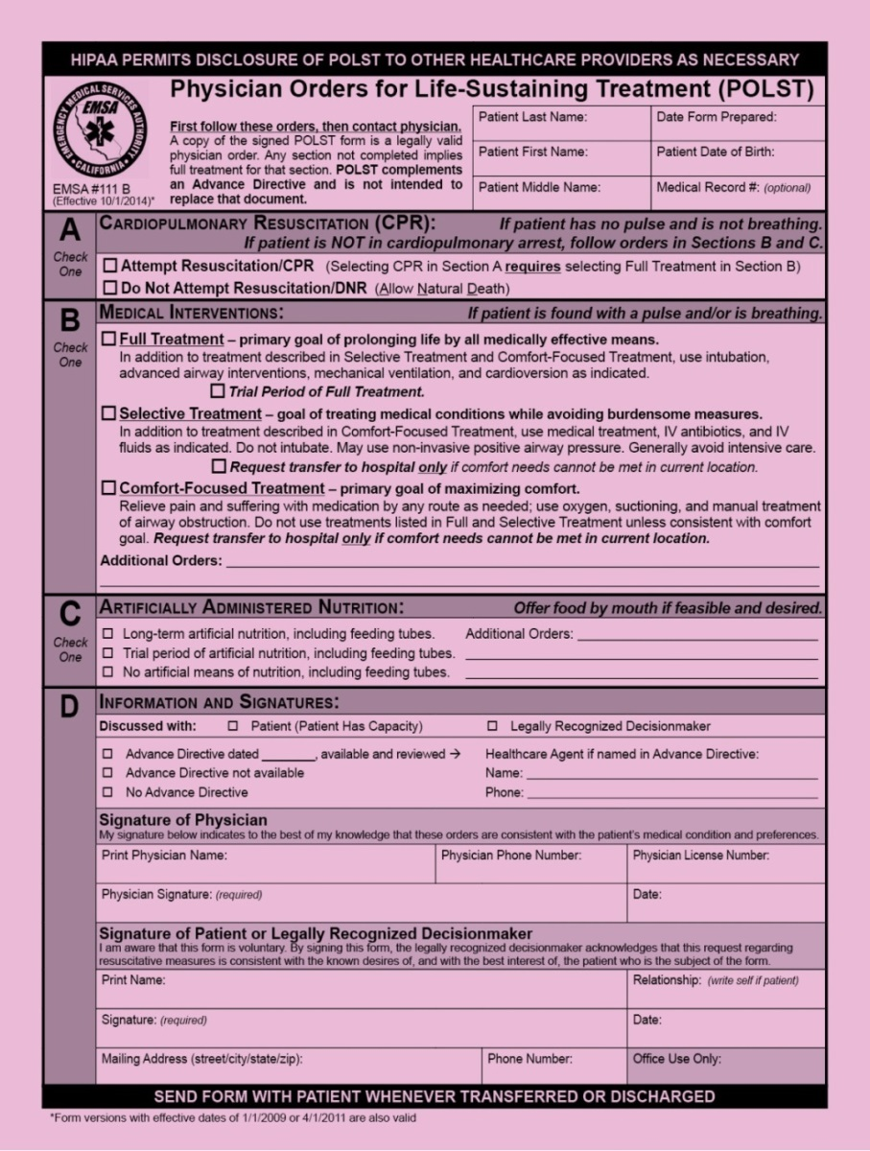

Slide 4
Why POLST (vs AHCD)?
Age 18
Complete an Advance Directive
C
O
N
V
E
R
S
A
T
I
O
N
Update Advance Directive Periodically
Diagnosed with Serious or Chronic, Progressive Illness (at any age)
Complete a POLST Form
Treatment Wishes Honored
Notes:
This slide shows where POLST fits into the Advance Care Planning Continuum.
Starts at age 18 with completing an AHCD.
Your AHCD should be updated periodically – check names, contact information, and healthcare wishes.
If you are diagnosed with a serious or chronic, progressive illness at any age, talk with your physician about completing a POLST form.
The goal is that your treatment wishes are honored.
What is the word along the left side? Conversation.
An ongoing conversation over the years with your healthcare decisionmaker, family, and healthcare provider is very important.

Slide 5
POLST Updates
Revised Form Effective
October 1, 2014
Preliminary data
POLST in SNFs
Status of POLST registry

Slide 6
Revised POLST Form
The National POLST Paradigm recommends periodically updating the form based on feedback from usage in the field.
Guiding Principle for Revisions: Changes made must provide substantial and significant improvement or clarification to the form.

Slide 7
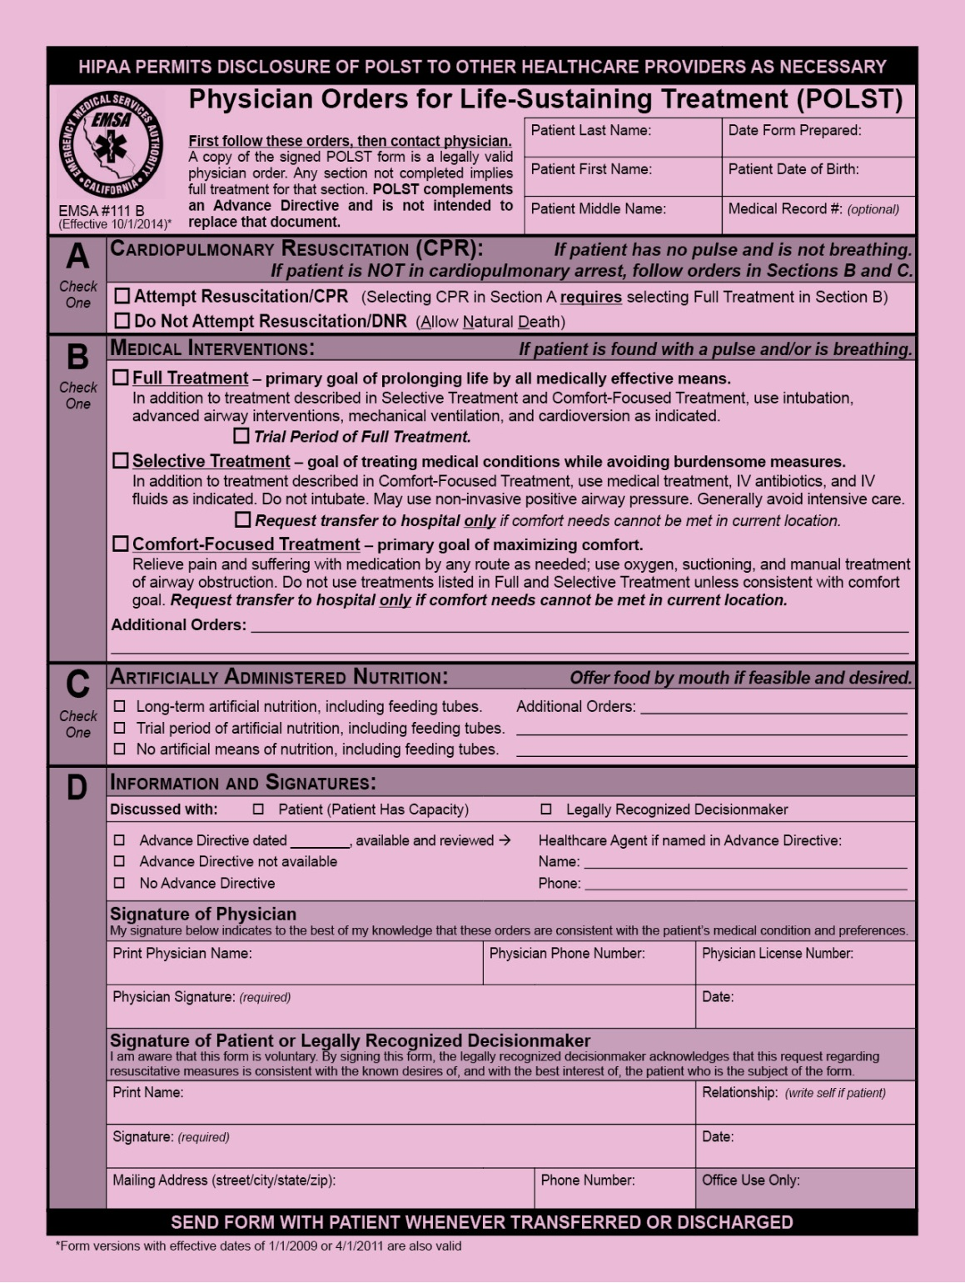
POLST Form 2014 Key Changes
Notes:
In order to be consistent with Section A, treatment choices for Sections B and C have been switched in their order, and each section begins with the most aggressive and invasive treatment choices.
In Section B, the choice of “Limited Additional Interventions” has been renamed to “Selective Treatment,” and the choice of “Comfort Measures Only” has been renamed to “Comfort-Focused Treatment.”
Goal statements have been added for each treatment choice in Section B. These descriptions help patients understand the goals of care within each option, and aim to promote quality conversations with a patient and/or legally recognized decisionmaker.

Slide 8
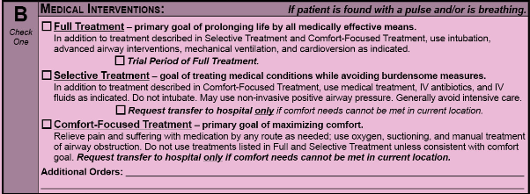
Section B: Medical Interventions
Notes:
Section B addresses medical interventions, and each option in Section B now includes a goal statement to help patients understand the goals of care within each option and help promote quality conversations with patients, family, and/or legally recognized decisionmaker:
Full Treatment – primary goal of prolonging life by all medically effective means. Includes a box which can be marked “Trial Period of Full Treatment.” This option is helpful for patients who want to try short-term ventilator support, but do not want prolonged life support, especially if they are not making progress.
Selective Treatment – goal of treating medical conditions while avoiding burdensome measures. Burdens of treatment may include complications, pain, or weakness. A check box is included for SNF patients, who may choose “Request transfer to hospital only if comfort needs cannot be met in current location.”
Comfort-Focused Treatment – primary goal of maximizing comfort. Care is focused on comfort, not on treating the person’s illnesses. Note the statement: “Request transfer to hospital only if comfort needs cannot be met in current location.”

Slide 9
Section C: Artificially Administered Nutrition
Notes:
The order of choices for Section C was also changed to be consistent with Section A. Each section now begins with the most aggressive intervention.

Slide 10
Section D: Information and Signatures
Notes:
In Section D, “Address” was clarified and now reads as “Mailing Address.”
“Office Use Only” is a place holder for future use by the anticipated establishment of a POLST Registry.
Note the asterisk at the bottom, *Form versions with effective dates of 1/1/2009 or 4/1/2011 are also valid.

Slide 11
California: POLST Progress
POLST Train-the-Trainer: Over 1,000 trained as POLST educators
The California POLST: 11 languages as well as Braille
Over ½ million forms distributed in the state

Slide 12
POLST in Skilled Facilities
California nursing home residents = 296,276
POLST completed = 181,410 (63%)
Minimum Data Set (MDS) 3.0 (resident assessment form for SNF) includes questions about POLST usage
Source: 2011 Nursing Home Minimum Data Set
www.cdph.ca.gov/programs/Inc/pages/mds.aspx
Notes:
- California nursing home residents = 296,276
- POLST completed = 181,410 (63%)
Minimum Data Set (MDS) 3.0, the resident assessment form used in nursing homes, includes questions about POLST usage. (Section S)
Most date is 2012

Slide 13
POLST in California Hospitals
65% of hospitals have a formal POLST policy
87% of hospitals have blank POLST forms available for patients
84% have POLST education for staff
Notes:
MOSTLY 2012 Survey data, unpublished.
Sugiyama T, Zingmond D, Lorenz KA, Diamant A, O'Malley K, Citko J, Gonzalez V, Wenger NS. Implementing physician orders for life-sustaining treatment in California hospitals: factors associated with adoption. J Am Geriatr Soc. 2013;61:1337-44.
These data are unpublished although could reference the ASBH abstract.
The reference for the 2012 data is unpublished (but could reference a SGIM abstract)
Most hospitals report they respect the orders in a POLST as described in AB3000

Slide 14
POLST in Assisted Living Facilities
85% had a specific place to keep the POLST (2012 survey assisted living facilities in the California Assisted Living Association)
74% of facilities had implemented POLST education for staff
75% admitted at least one resident who had a completed a POLST
Notes:
Current data likely to reflect more penetration.
Unpublished data.
Experience with implementation and utilization is growing.
Recently looked at barriers to POLST use and implementation in RCFE

Slide 15
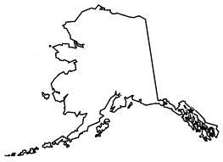
National POLST Paradigm Programs
www.polst.org
*As of September 2014
Developing Programs
Mature Programs
Endorsed Programs
Regionally Endorsed Program
Programs That Do Not Conform to POLST Requirements
No Program (Contacts)
Notes:
Here is a map of POLST programs across the US as of September 2014.
Currently, 47 states have POLST or similar programs
The pink and purple states have established POLST initiatives that are endorsed by the National POLST Task Force.
The pale pink states have Developing POLST programs. These states have submitted their POLST form to the National POLST Paradigm Task Force. Developing POLST programs may be at various stages of development, with the goal of working towards implementing the POLST program across the state.
Endorsed POLST programs are the darker pink states, which have statewide or regional POLST programs which are part of routine advance care planning in that area. These programs have addressed POLST legal and regulatory issues, as well as developing implementation and quality assurance strategies.
At this time, two states, Oregon and West Virginia, have Mature Status endorsement, which includes a statewide POLST program that is the standard preferred method of advance care planning for persons with serious illness or frailty. Mature programs are used by 50% or more of hospitals, nursing homes and hospices in each region.
The POLST system continues to develop across the United States. Information about the National POLST Paradigm program can be found at www.polst.org.

Slide 16
What’s Next: A POLST Registry?
Fulfill promise to honor wishes
Quality
Research
Notes:
POLST Registry:
Fulfill promise to honor wishes
Quality
Research

Slide 17
Advance Care Planning System

Slide 18
Why is POLST Ripe for a Registry?
Targeted to those likely to need medical intervention
Designed for use in split second
Standardized form
Healthcare provider involved in completion
There’s a community the “owns” POLST

Slide 19
Lessons from Oregon’s POLST Registry
Oregon has legislative mandate
On healthcare provider
To submit form

Slide 20
What’s it Take to Make a Registry Work?
IT Solution
Day-to-day Operations
Pilot Community(ies)
Mechanism for Statewide Spread

Slide 21
POLST Registry Legislation
SB 19 (Wolk)
Requires the State (CHHS) to establish an electronic POLST registry
Including rules for operation in compliance with HIPAA
Healthcare provider assisting patient with completing POLST must submit form
Unless patient chooses not to have it submitted

Slide 22
Enacted Legislation
2014 Legislative Session
Effective January 1, 2015

Slide 23
Right to Know
AB 2139 (Eggman) – Notification
When a healthcare provider (physician, surgeon, PA, NP) makes a diagnosis that a patient has a terminal illness
Requires provider to notify patient (or patient’s agent) of the right to receive comprehensive information and counseling regarding legal end-of-life options
Notification may be provided at time of diagnosis or subsequent visit

Slide 24
Right to Know (cont.)
AB 2139 (Eggman) – Provision of Information
Upon request of patient (or agent) provide comprehensive information and counseling regarding legal end-of-life options
Including hospice, prognosis, refusal / withdrawal, disease-targeted treatment, pain and symptom management, advance directive
May be verbal or written, can use fact sheets / websites, can occur over time, culturally sensitive
Can transfer patient to someone else to provide the information

Slide 25
CPR in Assisted Living
AB 2044 (Rodriguez)
Have at least 1 staff person trained in CPR and first aid on duty and on premises at all times
Does not require staff to perform CPR on residents who request to forego resuscitation, as indicated by a POLST or DNR

Slide 26
A Watershed Moment for Palliative Care
SB 1004 (Hernandez)
Establish Standards & Provide Technical Assistance for Medi-Cal Managed Care Plans to ensure delivery of Palliative Care Services.
Covered services include, but are not limited to
Hospice Services Provided Concurrently with Curative Treatment
Hospice Services Provided Regardless of Prognosis
Other Services Determined to be Appropriate
Establish Guidance on the Medical Conditions and Prognoses that render a beneficiary eligible for the palliative care services

Slide 27
Palliative Care Defined In Legislative Intent
SB 1004 (Hernandez)
Specialized medical care and emotional and spiritual support for people with serious advanced illnesses.
Relief of symptoms, pain, and stress of serious illness.
Improvement of quality of life for both the patient and family.
Appropriate care for any age and for any stage of serious illness, along with curative treatment.

Slide 28
Key Issues to be Determined
Potential population (conditions)
Types of services and providers
Performance and outcome measures
Fiscal model(s)

Slide 29
Preparing for SB1004
One size doesn’t fit all: different types of Medi-Cal and different delivery systems
Palliative Care providers
Health Plans

Slide 30
Populations Covered: Implications
Fee-for-service Medi-Cal
Medi-Cal Managed Care
Types of Medi-Medi Dual coverage:
Special Needs Plan Medicare Advantage
Cal MediConnect (Duals demonstration project)
Non-managed Medicare with Medi-Cal

Slide 31
How Can Palliative Care Providers Prepare?
Develop a plan
Talk to health plans about payment options
Hire
Train

Slide 32
^{DHCS Palliative Care Efforts}
SB 1004
Stakeholder Process
Pediatric Palliative Care Waiver
Section 2703 Health Homes
1115 Waiver Renewal:
Workforce Development – Increased Provider Training
Delivery System Reform Incentive Payments (DSRIP) 2.0
Coordinated Care Initiative

Slide 33
Pending Legislation
Legislative Session
February 27 – Bill introduction deadline
Spring – House of origin
Summer – Opposite house
Fall – Governor’s Signature
January - Effective

Slide 34
POLST Signature
AB 637 (Campos)
Currently POLST must be signed by a physician
Would authorize nurse practitioners and physician assistants to sign POLST
Acting under the supervision of physician
And within scope of practice

Slide 35
Advance Directives
AB 791 (Cooley)
Amends Medi-Cal Health Information Technology Plan
Establish process for
Completing & printing advance healthcare directive on-line
Upload and store AHCD
Display AHCD to authorized users

Slide 36
Right to Try
SB 149 (Stone)/AB 159 (Calderon)
Would permit making a investigational drug, biological product, or device available to terminal-ill patients
Would allow, but does not require, health insurance to cover cost
Would prohibit disciplinary action against physician
Notes:
Would permit a manufacturer of an investigational drug, biological product, or device to make the product available to eligible patients with terminal illnesses
Would allow, but does not require, a health benefit plan or governmental agency to provide coverage for the cost.
Would prohibit the Medical Board of California and the Osteopathic Medical Board of California from taking any disciplinary action against the license of a physician based solely on the physician's recommendation to an eligible patient regarding, or prescription for, or treatment with, an investigational drug, biological product, or device.

Slide 37
CCCC Position on Physician Assisted Death
The Coalition for Compassionate Care does not take a position on physician assisted death.
We are devoted to improving care. Work on systemic and meaningful solutions. Believe that access to quality palliative care would mean vast majority of people would not seek hastened death.
Notes:
CCCC is devoted to improving the culture of care for seriously-ill patients by making palliative care a normal part of life and health care.
We put our energy into issues that address systemic and meaningful solutions to enhancing the quality care for those chronically- or seriously-ill, or near the end of life.
We believe that with appropriate, compassionate, and excellent palliative care, an overwhelming majority of persons may never need to consider the notion of physician assistance in hastening their death.

Slide 38
End of Life Option Act
SB 128 (Wolk & Monning)
Request
By Qualified Individual (CA resident, self administer)
For Prescription for Aid-in-Dying
To Attending physician
Format of Request
Two oral requests (15+ days apart)
Written request
Signed & Dated
Witnessed (competent, voluntary, not coerced)
Two witnesses (not attending physician and not more than one that is (a) related or (b) own, operate, employed at health facility)

Slide 39
End of Life Option Act
Attending Physician
Determines
Competent
Terminally ill (6 months)
Voluntary
Qualified individual
Discuss
Diagnosis, prognosis, potential risks, probable result, possibility of not taking the medication, alternatives or additional treatment
Counsel on importance of having another person present when taking meds & not taking medication in public

Slide 40
End of Life Option Act
Attending Physician
Refer to consulting physician
Diagnosis, prognosis, competent
Refer to counseling if appropriate
Ensure
No coercion, informed consent, right to rescind
Comply with documentation requirements

Slide 41
Federal Policy: Healthcare Reform
In the last Congress:
The Patient Centered Quality Care for Life Act
The Palliative Care and Hospice Education and Training Act
New Congress = starting over again

Slide 42
Federal Policy
Value-based purchasing and alternative payment
Reducing readmissions
Integration of palliative care = powerful strategy for success under health care reform

Slide 43
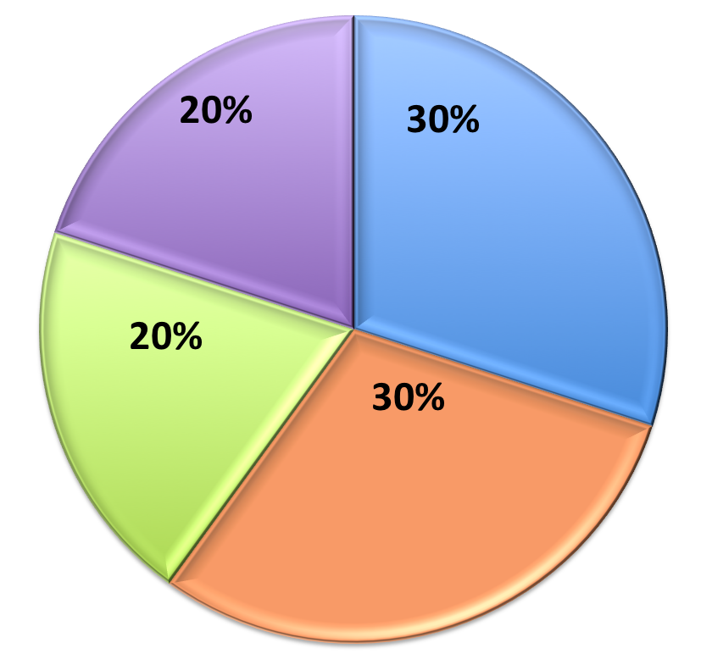
Hospital Value Based Purchasing FY 2015
Clinical Processes of Care
Patient Experience of Care
Efficiency
Outcome

Slide 44
Medicare
Physician Fee Schedule
Effective January 1, 2015
Will pay for non-face-to-face care coordination services furnished to Medicare beneficiaries with multiple chronic conditions
New current procedural terminology (CPT) for advance care planning

Slide 45
Testing New Models
Chronic Care Management
Oncology Care Model
Concurrent Care Model
Notes:
Chronic care management services, at least 20 minutes of clinical staff time directed by a physician or other qualified health care professional, per calendar month, with the following required elements: multiple (two or more) chronic conditions expected to last at least 12 months, or until the death of the patient; chronic conditions place the patient at significant risk of death, acute exacerbation/decompensation, or functional decline;
comprehensive care plan established, implemented, revised, or monitored.
CMMI - Oncology Care Model – under development – incentivizes oncology best practices - includes palliative care metrics (PC consultation) “Percentage of attributed OCM-FFS beneficiaries with at least one palliative care consultation per OCM-FFS episode”
to improve care coordination, appropriateness of care, and access for beneficiaries undergoing chemotherapy, resulting in improved health outcomes, higher quality care, and lower expenditures.
Hospices that apply and are selected to participate in Medicare Care Choices Model will provide services available under the Medicare hospice benefit for routine home care and inpatient respite levels of care that cannot be separately billed under Medicare Parts A, B, and D. These services must be available 24/7, 365 calendar days per year. CMS will pay a $400 per beneficiary per month fee to the Medicare Care Choices Model participating hospices for these services. Providers and suppliers furnishing curative services to beneficiaries participating in Medicare Care Choices Model will be able to continue to bill Medicare for the reasonable and necessary services they furnish.

Slide 46
Institutes of Medicine
Five Key Recommendations
Comprehensive care delivery system
Clinician-patient communication & advance care planning
Professional education & workforce development
Policies & payment reform
Public education & engagement

Slide 47
Q&A
Post questions in the chat or Q&A box to the right of your screen.

Slide 48
7th ANNUAL SUMMIT
APRIL 14-15, 2015
SACRAMENTO, CALIFORNIA
COALITIONCCC.ORG/SUMMIT
Robert M. Arnold, MD
Diana Dooley
Shirley Otis-Green, MSW, ACSW, LCSW, OSW-C
Christine, Ritchie, MD, MSPH, FACP, FAAHPM
Cardinale Smith, MD, MSCR
Notes:
Palliative care summit coming up in April…
Great speakers, including!

Slide 49
CoalitionCCC.org
(916) 489-2222 // info@coalitionccc.org

