Slide 1
Hospice and Palliative Care: the Distinctions and the Connections
Terri Warren, MSW
Executive Director
Providence TrinityCare Hospice
Palliative Care & TrinityKids Care

Slide 2
Where are we today?
Access to curative treatments and interventions
Environment of health care reform
Services
Benefit Structures

Slide 5
What We Have and What We Need:
Prevalence and Sufficiency of Palliative Care Services in California
Kathleen Kerr
Kerr Healthcare Analytics
California Healthcare Foundation | www.chcf.org

Slide 6
Defining need
Population that would benefit from PC:
Those with serious illness that resolves
Those with ongoing (years) of need
Those in the last year of life
For this analysis, estimate of need is based on the number of individuals in the last year of life
California Healthcare Foundation | www.chcf.org

Slide 7
Estimating Need: Number of deaths annually
Reports population figures, by county, from 2011
Reports deaths, by county, as a 3-year average (2010-2012)
California Healthcare Foundation | www.chcf.org

Slide 8
Estimating need: low-high estimates
“Low estimate of need” = # individuals dying of seven conditions
Cancer (all types)
Diabetes
Alzheimer’s disease
Coronary Heart Disease
Cerebrovascular Diseases (Stroke)
Chronic Lower Respiratory Diseases
Chronic Liver Disease and Cirrhosis
“High estimate of need” is all deaths excluding those caused by accidents, homicides, suicides
California Healthcare Foundation | www.chcf.org

Slide 9
Estimating need: low-high estimates
Low - estimate of need = 61% of all deaths
High - estimate of need = 93% of all deaths
California Healthcare Foundation | www.chcf.org

Slide 10
Ip pc: prevalence, capacity, sufficiency
369 acute care hospitals
186 (50.4%) with active IPPC programs
IPPC available in 39/58 (67%) CA counties
Contributing to more than 72,000 inpatient admissions each year
Current capacity is between 33-50% of need
California Healthcare Foundation | www.chcf.org

Slide 11
CBPC: prevalence, capacity, sufficiency
189 CBPC programs
Sponsored by 147 organizations
Programs available in 36/58 (62%) CA counties
Serving more than 53,000 individuals annually
Current capacity is between 24-37% of need
California Healthcare Foundation | www.chcf.org

Slide 12
The hospice & Palliative care philosophy
Hospice is a special way of caring for people with life-limiting illnesses that includes caring for the physical, emotional, social and spiritual parts of the “whole” person focused on comfort (palliative) rather than curative care
Focuses on quality of life for individuals and their family caregivers, helping them live as fully and completely as they wish, with those important to them, in their own familiar setting

Slide 13
The hospice & Palliative care philosophy
Definition: Center for Medicare and Medicaid Services
“Palliative care” means patient and family-centered care that optimizes quality of life by anticipating, preventing, and treating suffering. Palliative care throughout the continuum of illness involves addressing physical, intellectual, emotional, social, and spiritual needs and to facilitate patient autonomy, access to information, and choice.

Slide 14
Hospice benefit
Considered a model for quality compassionate care for people facing a life-limiting illness, hospice provides expert medical care, pain and symptom management, emotional and spiritual support tailored to the patients wishes. Supportive care is also provided to the patients loved ones.
Hospice focuses on caring, not curing
Provided by an interdisciplinary team
Bundled payment, per diem rate designed to provide supportive care for months

Slide 15
Facts and figures
The median (50th percentile) length of service in 2013 was 18.5 days, a decrease from 18.7 days in 2012
Yet the ALOS increased from 71.8 days in 2012 to 72.6 in 2013
Over the past several years the median LOS has declined while the average LOS has increased
In 2013, 34.5% died or were discharged within 7 days of admission
NHPCO, Facts and Figures 2013

Slide 16
Facts and figures
Over 5,800 hospice in the US
Over 78% of programs are small, with fewer than 500 admissions per year
70% of hospice programs are for-profit, with the number of not-for-profits decreasing each year
Annually the top admitting diagnoses for hospices:
All Cancers (36.5%)
Dementia (15.2%)
Heart Disease (13.4%)
Lung Disease (9.9%)
Other (6.9%)
NHPCO, Facts and Figures 2013

Slide 17
Levels of care
Routine
Most common, patient receives hospice care in the place s/he resides. Hospice received a per diem rate for services. In 2013, 94.1% of Medicare hospice days.
Respite
Inpatient respite offers short term care (5 days maximum per episode) in an approved, contracted facility in order to provide respite for the caregiver. In 2013, 0.3% of all Medicare hospice days.
Continuous Care
Patient receives hospice care consisting predominantly of licensed nursing care on a continuous basis at home (minimum 8 hours in 24 hour period). Furnished during brief periods of crisis and only as necessary to maintain the patient at home. Requires daily RN or MD assessment to justify this level of care – hospice is paid hourly. In 2013, 0.8% of Medicare hospice days.
General Inpatient
Patient receives hospice care in a Medicare certified, contracted inpatient facility (acute medical center, skilled nursing facility, licensed hospice staffed with RNs providing direct patient care 24 hours a day) for pain control or acute or complex symptom management which cannot be managed in other settings. Significantly higher per diem payment to hospice. In 2013, 4.8% up from 2.7% in 2012 of Medicare hospice days.

Slide 18
OIG Work Plan
2013 – Looking closely at hospitals examining the extent to which acute hospitals discharge beneficiaries after short stay to hospice facilities. Medicare pays the full PPS rate to hospitals that discharge to hospice, versus a reduced payment for short acute stay with transfer to another PPS hospital for certain DRGs or to certain post acute facilities i.e., a SNF.
2014 area of focus …. GIP remains area of focus for hospital, referring physicians, and hospices justifying medical necessity for that level of intervention.

Slide 19
Beauty of hospice
Support over time for patient and family, focus on maximizing quality of each day, patient and family prepared for what to expect.

Slide 20
challenges
Shorter length of stay challenges
Prognostication isn’t our strong suit
Choosing comfort in place of some curative treatments increasingly difficult
We need concurrent care!

Slide 21
Pediatrics - concurrent care Provision 2302 of the Affordable Care Act
The Patient Protection and Affordable Care Act (ACA) changed that situation. It requires all state Medicaid programs to pay for both curative and hospice services for children under age 21 who qualify. On March 23, 2010, President Obama signed ACA into law enacting a new provision, Section 2302, termed the “Concurrent Care for Children” Requirement (CCCR).

Slide 22
Pediatrics - concurrent care Provision 2302 of the Affordable Care Act
Section 2302 states that a child who is eligible for and receives hospice care must also have all other services provided, or have payment made for, services that are related to the treatment of the child’s condition. This provision affects children who are eligible for Medicaid or the Children’s Health Insurance Program (CHIP). In its simplest form, implementation of this provision could be accomplished by the state Medicaid agency eliminating any provider claims that deny or delay concurrent curative care and hospice claims.

Slide 23
Pediatrics - concurrent care Significant barriers
Physicians must still certify that that child is within the last six months of life, if the disease runs its normal course.
Children who quality for this benefit remain limited to the existing array of Medicaid hospice services and other existing Medicaid services covered by a state. However, a child may be simultaneously enrolled in other programs that provide supplemental services such as home and community-based service (HCBS) waivers.

Slide 24
Pediatrics partners for children (PFC) Palliative Care in the Community
PFC is a program for children with special health care needs that are life-threatening.
The PFC program provides supportive comfort services, including care coordination and pain management that will help support your child through the illness as you continue to seek ongoing treatment for your child.

Slide 25
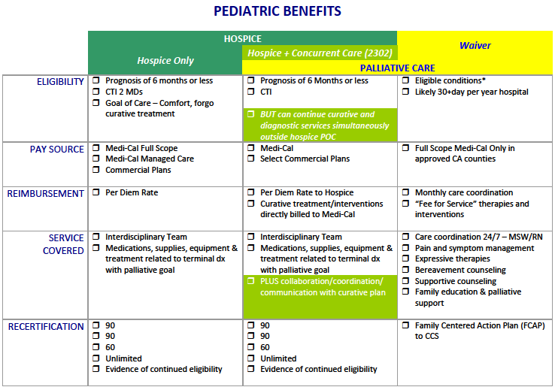

Slide 26
Expansion of covered services CARE choices model Movement Toward Current Care
Through the Medicare Care Choice Model, the Centers for Medicare & Medicaid Services (CMS) will provide a new option for Medicare beneficiaries to receive palliative care services from certain hospice providers while concurrently receiving services provided by their curative care providers. CMS will evaluate whether providing hospice services can improve the quality of life and care received by Medicare beneficiaries, increase patient satisfaction, and reduce Medicare expenditures.

Slide 27
Expansion of covered services Initiative Details
CMS will limit participation to beneficiaries with advanced cancers, chronic obstructive pulmonary disease, congestive heart failure and HIV/AIDS
CMS will select at least 30 rural and urban Medicare certified and enrolled hospices that have demonstrated experience with an established network of providers for referrals to hospice
CMS expects to enroll 30,000 beneficiaries throughout a 3-year period

Slide 28
Expansion of covered services
Commercial Health Plans, i.e., Aetna
In California, SB 1004 passed in 2014

Slide 29
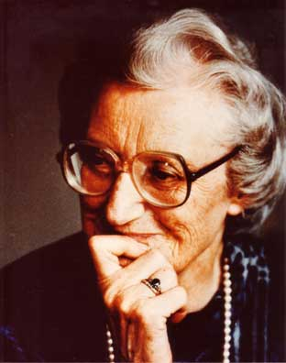
“You matter because of who you are. You matter to the last moment of your life, and we will do all we can, not only to help you die peacefully, but also to live until you die.”
Dame Cicely Saunders

Slide 30
Focus on the patient!

Slide 31
Providence TrinityCare Hospice
www.trinitycarehospice.org
310-543-3400
Terri Warren, MSW
Executive Director
terri.warren2@providence.org

