Slide 1
Geriatricizing Medical Care:
Fixing the Care System for Frail Elders
Joanne Lynn, MD, MA, MS
Director, Altarum Institute Center
for Elder Care and Advanced Illness
March 12, 2015
2015 Palliative Care Conference

Slide 2
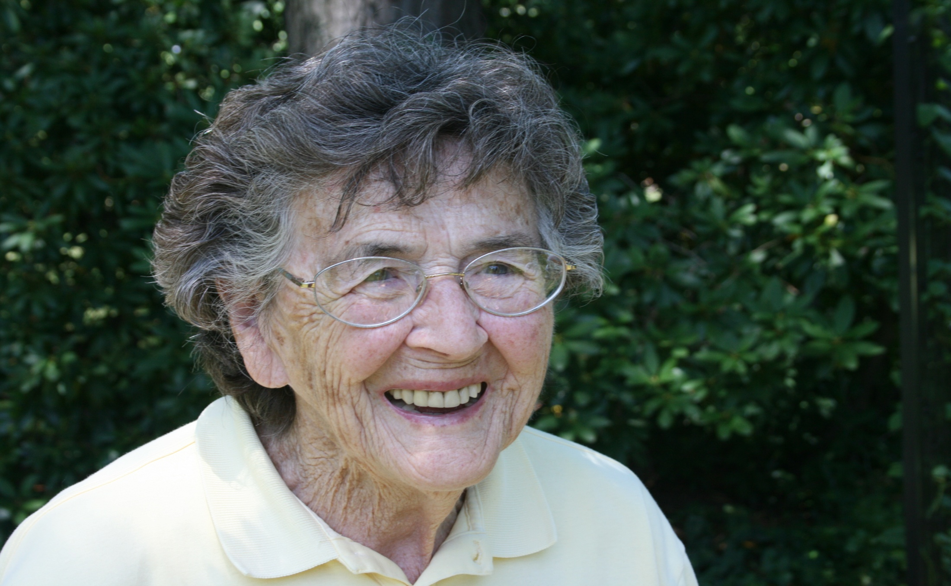
My Mother’s Broken Back

Slide 3
Single Classic “Terminal” Disease: “Dying”
Hospice
starts
Mostly cancer
Function
Death
Onset incurable disease
Time
Often a few years, but decline usually over a few months
Notes:
Aggressive cancer?
Major organ failure with exacerbations?
A long decline into frailty and dementia?

Slide 4
Prolonged dwindling
Mostly frailty and dementia
Now, most Americans have this course.
The numbers will triple in 30 years.
Function
Death
Onset could be deficits in ADL, speech, ambulation
Time
Quite variable, often 6-8 years

Slide 5
Context – Salient Facts
Frailty is now the dominant trajectory of late life
Dramatic overinvestment in medical interventions -- and serious gaps in supportive services like housing, transportation, personal care, caregiver support, and food
Experience: mismatch of availability and priorities for the cohort, with frustration and fear, impoverishment, loss of comfort and dignity, isolation (of frail elder and caregiver)
Numbers due to rise dramatically in the next few decades
Serious challenge to the economy
Serious risk of abandonment
In short – Palliative Care has to participate in solving LTC

Slide 6
Ratio of Social to Health Service Expenditures Using 2009 Data

Slide 7
Disaster for the Frail Elderly: A Root Cause
Social Services
Funded as safety net
Under-measured
Many programs, many gaps
Inappropriate
Unreliable
Unmanaged
Wasteful “care”
No Integrator
Medical Services
Open-ended funding
Inappropriate “standard” goals
Dysfx quality measures

Slide 8
Strengths to Build on
Care Transitions and Readmissions work
Medicare entitlement
Medicare “low value services” and waste (ineffective or unwanted)
Near-universal risk, near universal lack of protection, for costs of long-term services and supports
Elders and family members vote – family caregiver organizing
The demographics are immovable and foreboding
Novel opportunities like CMMI innovations
Many demos and research implementations of better medical care, more reliable supportive services
Multiple communities with leaders engaged and willing

Slide 9

The Community-based Care Transitions Program (CCTP)
A strategic partnership between Palomar Health, Scripps Health, Sharp HealthCare, the UCSD Health System
– 11 hospitals/13 campuses, and AIS/County of San Diego
  Goals of the Community-based Care Transitions Program (CCTP):
      Improve transitions from the inpatient hospital setting to community
      Improve quality of care
        Reduce readmissions for high risk beneficiaries, and
        Document measureable savings to the Medicare program
Notes:
The Community-based Care Transitions Program (CCTP) is a federal program mandated by Section 3026 of the Affordable Care Act.
It provides funding for testing models of care that reduce the 30-Day All Cause Readmission Rate for high risk Medicare-Fee-For-Service beneficiaries.
CMS awarded San Diego the largest CCTP in the country in late 2012. The program, named the San Diego Care Transitions Partnership (SDCTP), is a collaboration between Palomar Health, Scripps Health, Sharp HealthCare, the UCSD Health System (13 hospitals), and the County of San Diego/Aging & Independence Services.
The program rollout began at the end of Jan 2013 and was completed in late May 2013. Since it began, the SDCTP has progressively expanded its footprint.
On average, the program is serving just over [1,400] patients each month.
As of [October 31, 2014] the SDCTP program has provided services to over [21,000] high-risk individuals.
The SDCTP has achieved all of the stated goals of the program and more.

Slide 10
CCTP: Impact of Readmission Rates cont.
Community-Based Care Transitions Program (CCTP)
Reduction in 30 Day Hospital Readmission Rates
January 2013 to January 2014
Target Group baseline: CCTP participants 30 day readmission rate from 2012
CCTP Participants: Those who completed services (CCTP Completers) and those who did not complete all aspects of the program
CCTP Completers: CCTP participants who completed all aspects of the program
Notes:
In 2012, before CCTP began, the estimated 30-Day Readmission Rate for our Target Population was 39.8%. Based on the most recent data available, the 30-Day Readmission Rate for San Diego’s CCTP participants had dropped to [13.9%] by January 31, 2014, a 65.1% reduction. Like the larger Medicare FFS 30-Day All Cause Readmission Rate, 13.9% is lower than the national average of [15.9%].
Patients who complete their CCTP program have an even lower estimated 30-Day Readmission Rate of [11.7%], which is a 70.6% reduction from the baseline rate.
Effectively decreasing the number of readmissions is not only good for those patients and families who are affected, but also can result in substantial Medicare savings.
In 2012, the average cost of a readmission in San Diego County was $12,922. In Calendar Year 2013, reducing the 30-day Readmission Rate resulted in keeping approximately 437 individuals from readmitting to the hospital. After taking into account the CY 2013 CMS funds paid the SDCTP, the estimated net savings to Medicare was just over $2.6 Million.

Slide 11
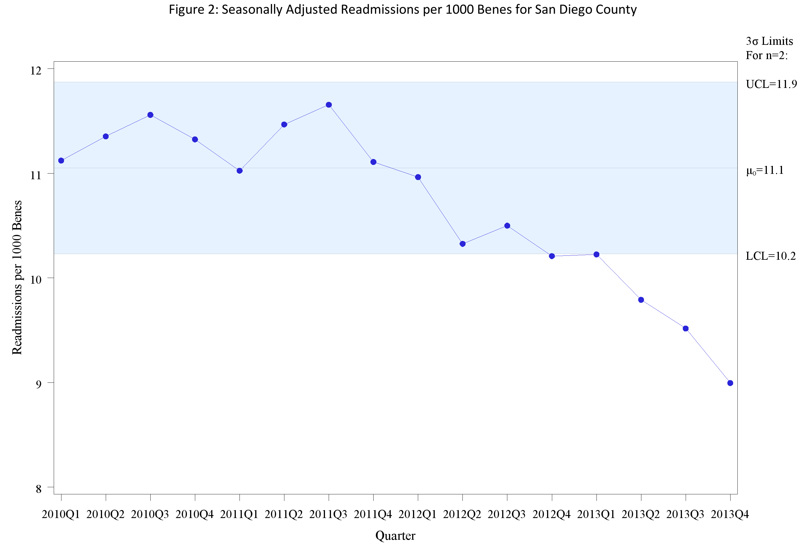
San Diego County:
Seasonally Adjusted Readmissions per 1000 Beneficiaries

Slide 12
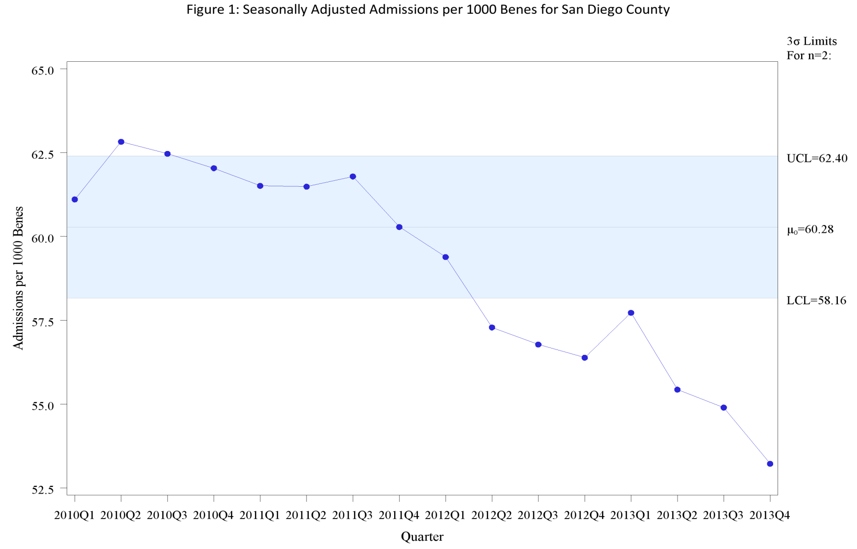
San Diego County:
Seasonally Adjusted Admissions per 1000 Beneficiaries

Slide 13
My Mother’s Broken Back

Slide 14



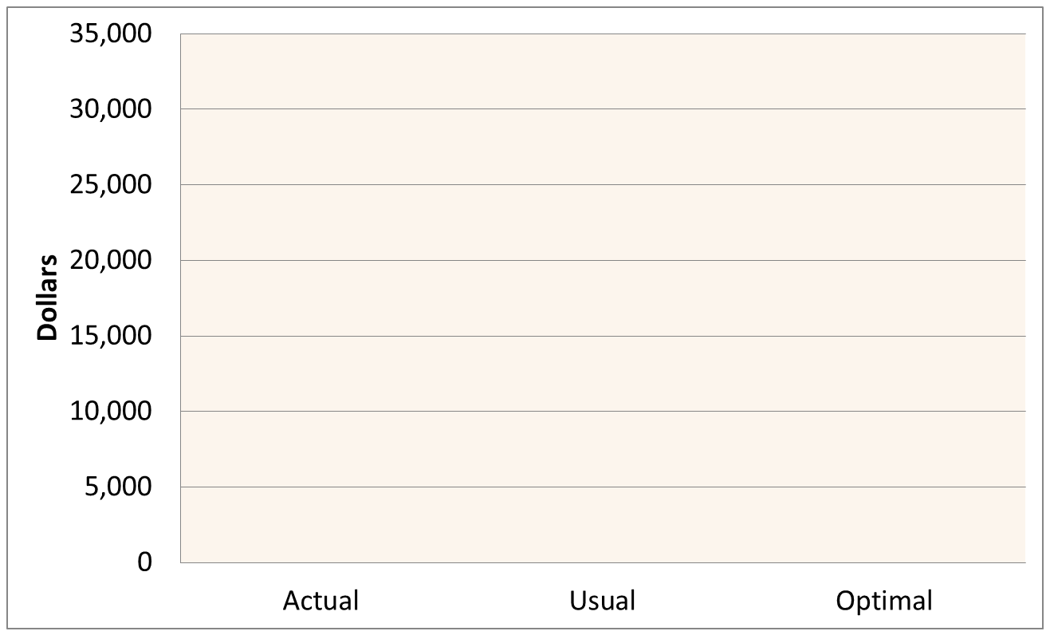
The Cost of a Collapsed Vertebra in Medicare

Slide 15
(Y axis: 1 = average labor income, ages 30-49)
(X axis: Age)
U.S. Consumption by Age
Public $ towards Health Care per capita
Private $ towards Health Care per capita
1960
1981
2007
Source: U.S. National Transfer Accounts, Lee and Donehower, 2011.
Also in Aging and the Macroeconomy, National Academy of Sciences, 2013

Slide 16
The MediCaring Community Model: Core Elements
Frail elders enrolled in a geographic community:
(e.g., >65 w/2+ ADLs, dementia, or 80+)
Longitudinal, person-driven care plans
Medical care tailored to frail elders (including at home)
Incorporating health, social, and supportive services
Monitoring and improvement guided by a Community Board
Core funding derived from shared savings from current medical overuse (e.g., a modified ACO structure)

Slide 17
Pragmatic Definition of Frail Elders
And any of these:
ADL>1
Constant supervision
Diagnosis likely to meet
above criteria within
a year or two
If at least one of these,
Unless opt out
YES
Frail Elder Cohort,
Needing MediCaring*
>64yo
If None
of Those
With Opt In
Or, >84yo
*MediCaring denotes services customized to frail elders, including care planning,
continuity, 24/7 on-call, services to the home, caregiver support

Slide 18
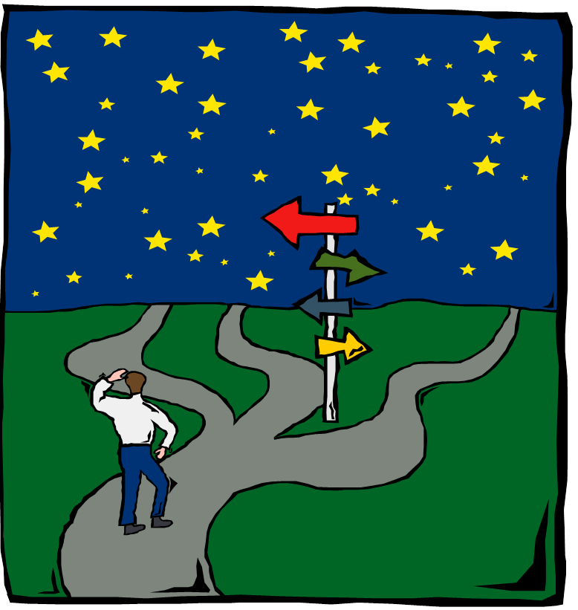

COMPREHENSIVE
UNDERSTANDING
PERSON-CENTERED
CARE PLAN

Slide 19
Steps in optimal care planning
Targeting who needs care planning – starting in Medicare – mainly frail, physically disabled, mentally disabled, ESRD, and end-of-life
Care Planning
  Current patient/family situation
  Likely future situation(s) with various strategies – and settle on relevant timeframe
  Patient/family priorities – hopes, fears, values – GOALS
  Negotiated, patient-driven care plan
  Available to those who need it, promptly
Evaluation and Feedback – system learning
Care plan use in system management – supply and quality issues for community

Slide 20
Care Plan Decision Modifiers
Patient/family preferences (values, priorities, wishes, adv directives, expectations, etc…)
Patient situation (access to care, support, resources, setting, transportation, etc…)
Patient allergies/intolerances
Goals
Desired outcomes and milestones
Readiness
Prognosis
Related Conditions
Related Interventions
Progress
Interventions/Actions
(e.g. medications, wound care, procedures, tests, diet, behavior changes, exercise, consults, rehab, calling MD for symptoms, education, anticipatory guidance, services, support, etc…)
Start/stop date, interval
Authorizing/responsible parties/roles/contact info
Setting of care
Instructions/parameters
Supplies/Vendors
Planned assessments
Expected outcomes
Related Conditions
Status of intervention
Health Conditions/ Concerns
fr
Care
Plan
Active Problems
Disease Progression
Prioritize
Orders, etc..
Risks/Concerns:
Wellness
Barriers
Injury (e.g. falls)
Illness (e.g. ulcers, cancer, stroke, hypoglycemia, hepatitis, diarrhea, depression, etc…)
Barriers
Decision
Support
Outcomes
Decision
Support
Patient Status
Functional
Cognitive
Physical
Environmental
Disabilities/
Concerns
Assessments
Outcomes
Risk Factors
Age, gender
Significant Past Medical/Surgical Hx
Family Hx, Race/Ethnicity, Genetics
Historical exposures/lifestyle (e.g. alcohol, smoke, radiation, diet, exercise, workplace, sexual…)
Side effects
Risks
The Care Plan (Concerns, Goals, Interventions , and Care Team), along with Risk Factors and Decision Modifiers, iteratively evolve over time
20
L Garber, for ONC S&I LCC

Slide 21
Thus – the care plan is showing up
Already a core commitment of (and requirement for) PACE (Program of all-inclusive care of the elderly), home care, and hospice
Central to the new Chronic Care Coordination service (using new CCM code = ~$42/mo/person to physician delivering a set of chronic care coordination services)
Thin version (for only a couple of days) in transitions and referrals in Meaningful Use 3 (proposed)

Slide 22
Better Geriatric Medicine
Patient/family driven
Often focused on comfort, meaningfulness, confidence
Requires intimate knowledge, which requires continuity
Usually, fewer medications, fewer specialists, fewer tests
Focus on living well with problems, not often on cures
Services often given at home

Slide 23
The Chronic Care Management Code
List of Elements “typically included” in a Care Plan
Problem list; expected outcome and prognosis; measureable treatment goals
Symptom management and planned interventions (including preventive care)
Community/social services
Plan for care coordination with other providers
Medication management
Responsible individual for each intervention
Requirements for periodic review/revision

Slide 24
What about an "Advance Care Plan?"
Have lifespan and dying be part of care planning
Include emergency plans like POLST (http://www.wvendoflife.org/MediaLibraries/WVCEOLC/Media/public/Post-Form-2012-rev-pink-SAMPLE.pdf )
Designate surrogate decision-maker(s)
Document along with care plan, file in eDirective Registry (fax to 304-293-7442)
Update and feedback along with other plan elements

Slide 25
What will a local manager need?
Tools for monitoring – data, metrics
Skills in coalition-building and governance
Visibility, value to local residents
Funding – perhaps shared savings
Some authority to speak out, cajole, create incentives and costs of various sorts
A commitment to efficiency as well as quality

Slide 26



BÄTTRE LIV FÖR DE MEST SJUKA ÄLDRE
I JÖNKÖPINGS LÄN
– KOMMUNER OCH LANDSTING TILLSAMMANS
[better life for the elderly people in Jonkoping}
MÄTTAVLA [dashboard]

Slide 27
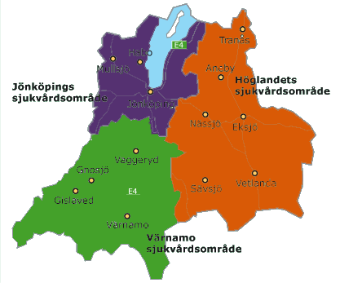
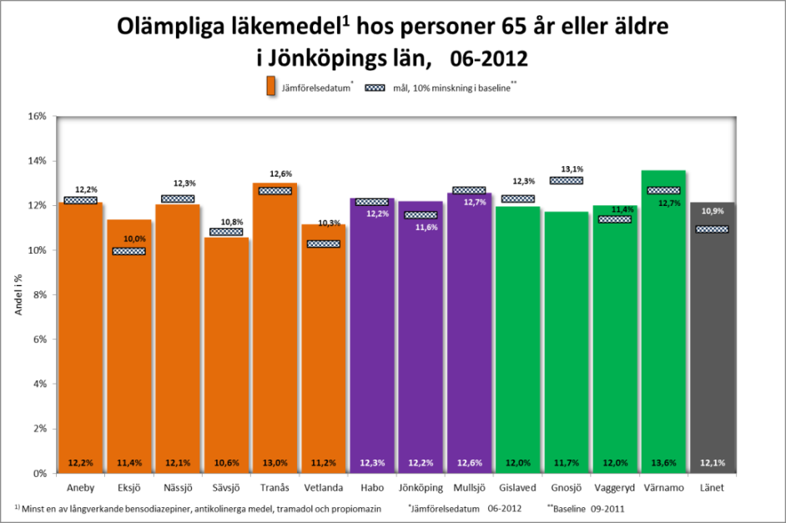
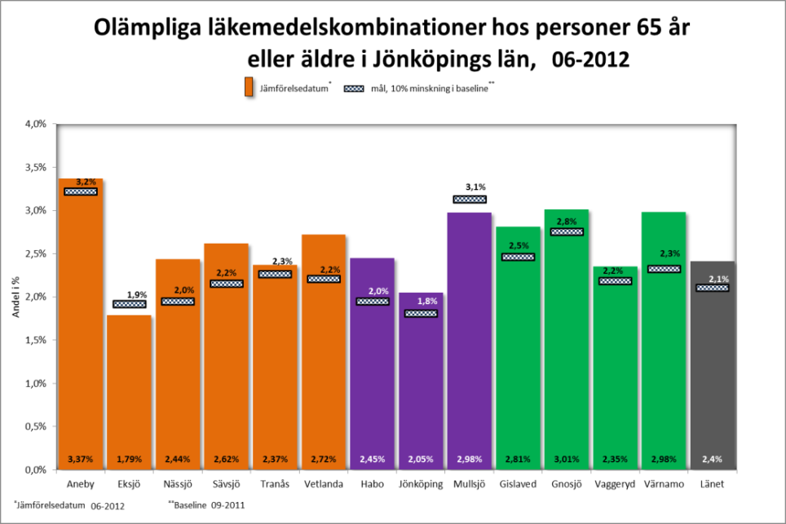
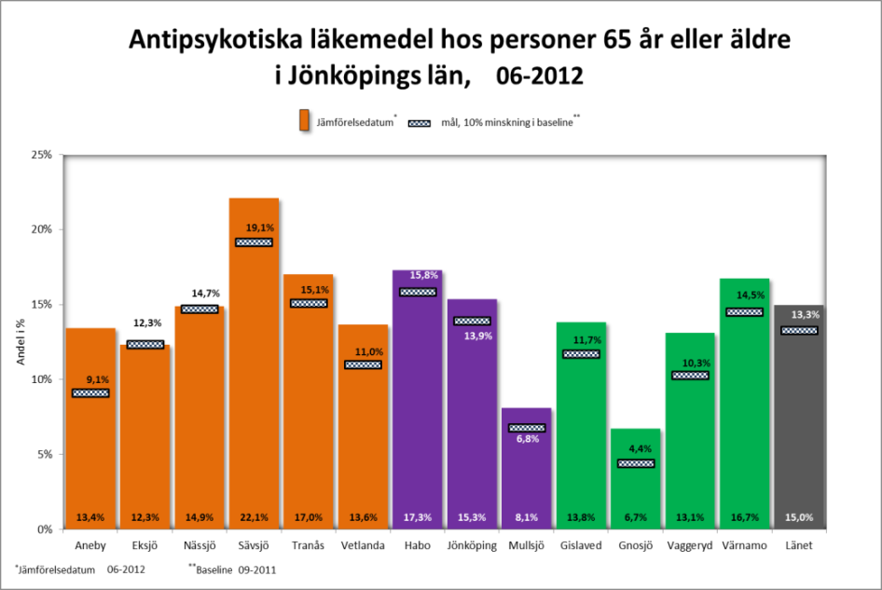
Äldres läkemedelsanvändning i Jönköpings län
Jonkoping hospitals
and municipalities

Slide 28
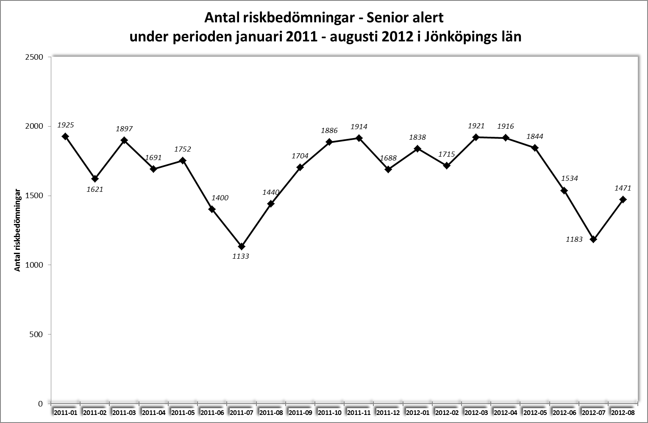
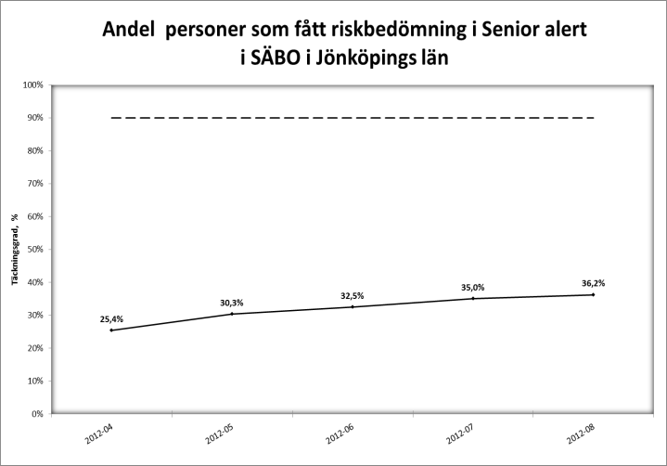
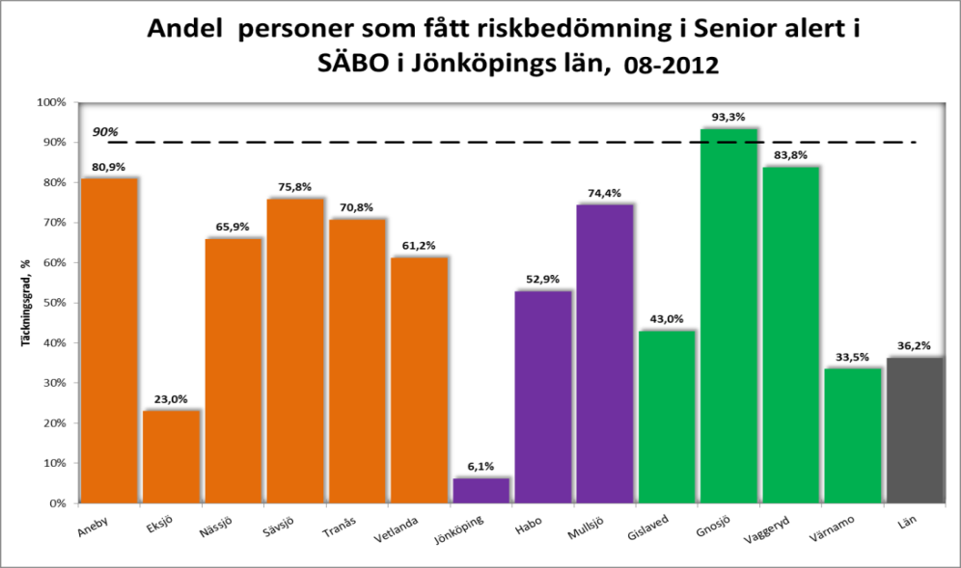
Pressure ulcer rate for
People living in service homes
Pressure ulcer risk assessment
In service homes

Slide 29
Patient- Reported Pursuit of Goals
Uneven interval, multiple reporting strategies
Date | Score
7/1/2012 | 2
8/3/2012 | 4
8/8/2012 | 3
10/12/2012 | 1
2/28/2013 | 4
3/2/2013 | 3
5/23/2013 | 0
6/1/2013 | 3
6/30/2013 | 4
Notes:
1.10.14 [HLS]-

Slide 30

If we had…
The Cohort - Services and processes tailored to frailty
The Services – Appropriate for frail elders
The Care plans – Negotiated for each frail elder
The Scope - Include long term supports and services
The local monitor- manager
THEN – My mother,
and your mother,
would have what they need.

