Slide 1
MemorialCare Health System’s Approach to Palliative Care
Thursday, March 12, 2015
HASC/IE Palliative Care Conference
James Leo, MD, FACP, FCCP
Medical Director, Best Practice & Clinical Outcomes
MemorialCare Health System

Slide 2
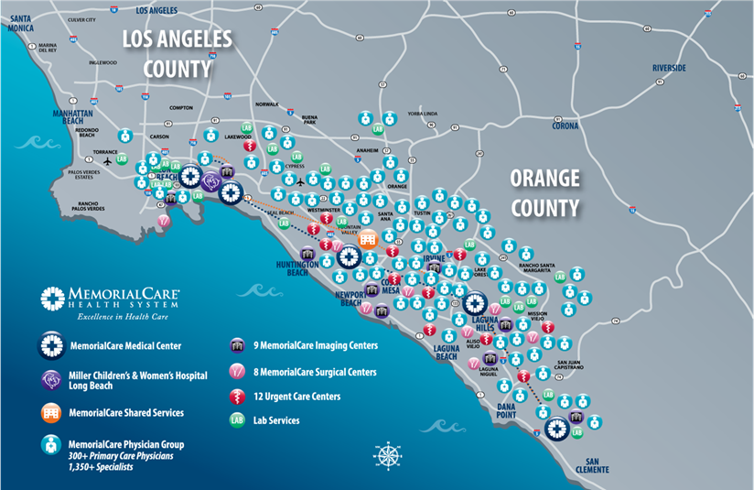
MemorialCare Health System

Slide 3

Key Statistics
Total Assets $3.059 billion
Annual Revenues $1.999 billion
Bond Rating AA- stable
Patient Discharges 68,924
Patient Days 288,139
ER Visits 198,199
Senior Lives 54,914
Commercial Lives 123,907
Babies Delivered 10,413
Surgeries 34,516
Employees 11,192
Affiliated Physicians 2,600 (majority
independent)
Residents 165 (PGY1-7)
Notes:
Solidifying our position in the ranks of excellent healthcare institutions will come through a focus on quality, safety and service.
It may also come from smart growth…pursuing strategic growth opportunities in our region to expand our reach/service area in SoCal.
We are always looking for opportunities that make sense. WE’re selective and will not expand just for size sake, but if it makes sense and can enhance our ability to serve our communities in an integrated/more cost effective way, we will evaluate it.

Slide 4
Part of a Larger Vision
Linking the Triple Aim to Strategy
Better patient experience
Better health of the population
Lower per capita cost
Notes:
Triple Aim includes engagement of patient & family, provider and workforce in a balanced and coordinate manner to achieve best aligned results

Slide 5
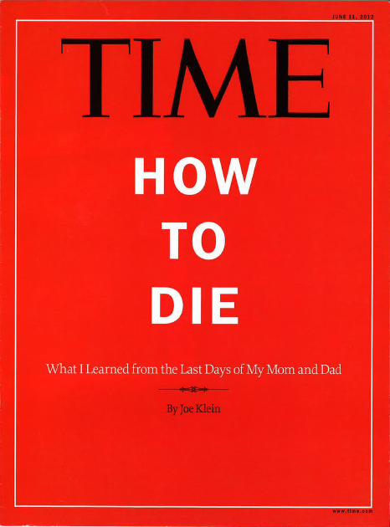


Top of Mind

Slide 6
Palliative Care Best Practice Team
Leveraging a “Clinical/Business” Plan to Address Barriers and Create Momentum
Notes:
Pull in PS slide on PS membership and BPT
Original business plan

Slide 7
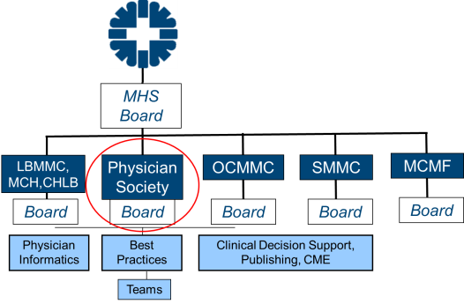
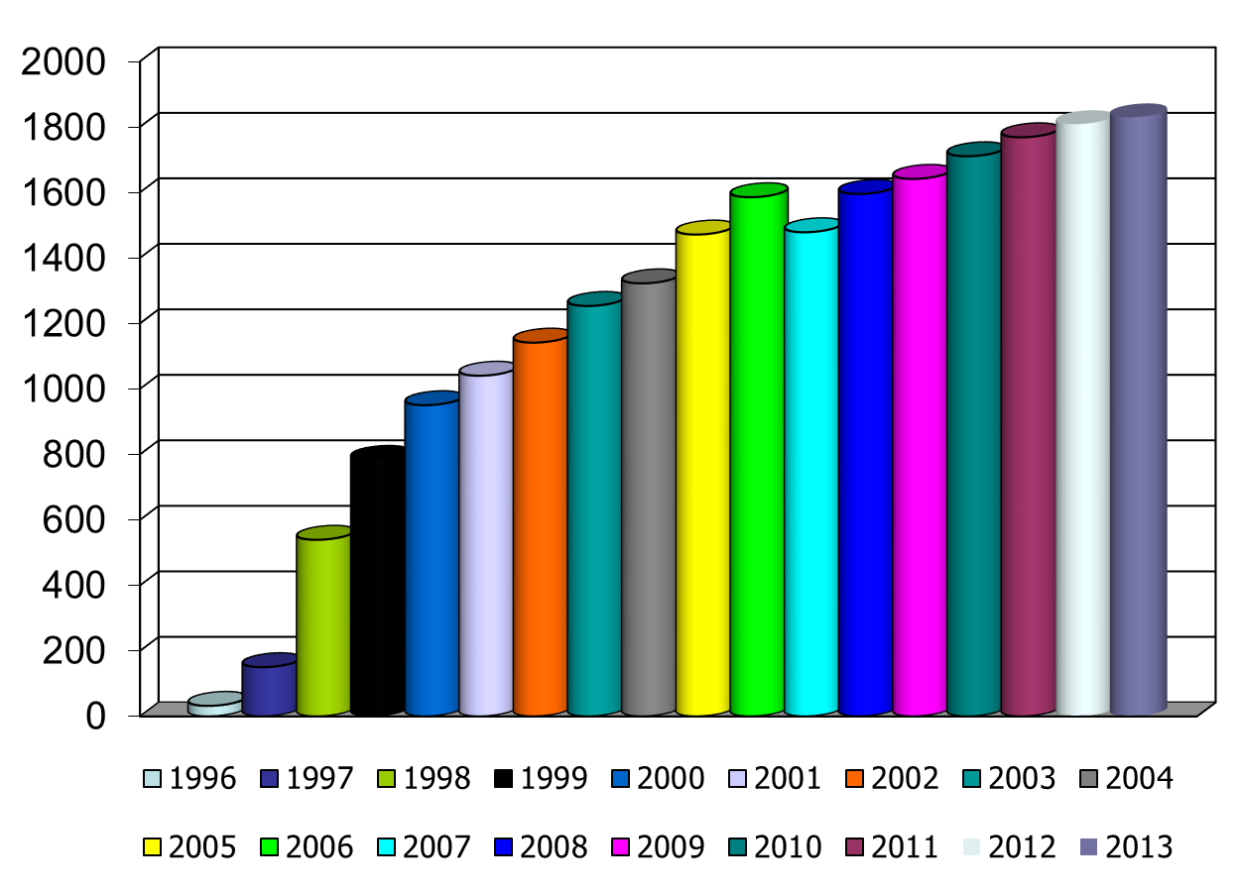
The Role of MemorialCare’s Physician Society
The Physician Society A professional association of physicians who are committed to participating in the development and utilization of evidence-based/best practice medicine | The Society Board’s role
Responsibilities Create the expectations for clinical performance across the enterprise Lead development of best practice Implementation of best practice guidelines at the bedside/visit Leadership of physician informatics and outcomes | Growth in Membership
95% of admissions
Notes:
Jim (1:30) Cum: 6:00
usual Physician Society slide

Slide 8
2012: A new Palliative Care BPT
Where we started: Survey says!
We asked the question:
  “Overall, how would you rate the provision of palliative care services for all applicable patients at your location”
We asked the question:
  “How would you rate the continuity between inpatient and outpatient palliative care services”
Notes:
Slide 17-19 Went back to our Clinical/Business plan slides to PG/Execs from 2/13 and pulled these forward to set the Barrier Stage…

Slide 9
We knew who would benefit
But there were barriers to surmount
Patients Who Would Benefit
Not surprised if the patient died in the next year
>1 admission for same condition within few months
Difficult-to-control physical/psychological symptoms
Complex care requirements (e.g., physical dependency, home support for ventilator, pain pump, antibiotics, feedings etc…)
Decline in function, feeding intolerance or unintended weight loss
Weissman DE et al. J Pal Med., 2011.
Across the country, similar barriers to implementing Palliative Care programs:
Physician attitudes toward program
Internal marketing of resources for physicians
Physician time/resources for education
Perceived costs of building program
Community perception
Coverage/reimbursement

Slide 10
Our “Snapshot State” back then
No different…
Key perceptions from team members:
  Incomplete and differing programs at each campus
  Variable and uncertain integration with the outpatient environment
  Varied perception (often suspicious) of Palliative Care by community physicians
  Significant opportunity to reduce suffering of patients during chronic illness and at end of life

Slide 11
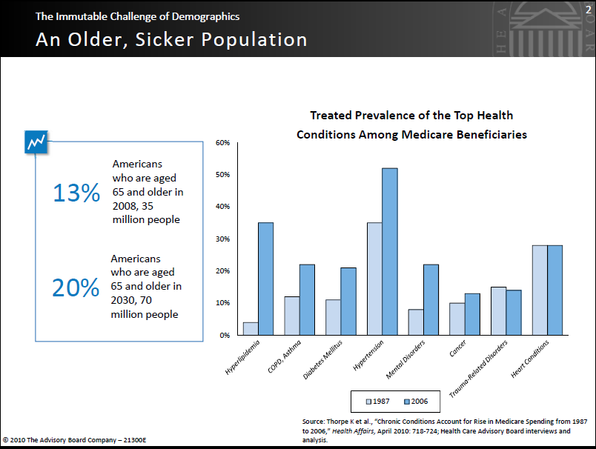
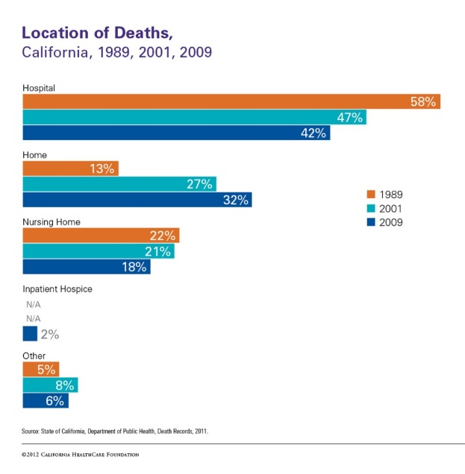
Key BPT Activities 2012-13
Surveyed the literature
Surveyed payors stances
Formed task forces to do further study
Created clinical / business plan for our Top 10 Recommendations for MemorialCare
  Presented to senior leadership Feb’13, two thumbs up!
Continued Palliative Care BPT oversight
Notes:
Slide 20-21 Key BPT Activities 2012-13 and our original Top 10

Slide 12
Overarching “Top 10”
System-Wide Recommendations
Set our Vision Gain agreement on what is “Good Palliative Care” Name It
Action the Key Improvement Opportunities Develop and Implement Best Practice Tools Build and Implement Referral Triggers to “local service” Evolve our use of POLST, leveraging the EMR Create Seamless Handoffs across Continuum (EMR & Human)
Provide Education Develop Education Content and Plan for All Key Caregivers Develop & Provide Patient & Family Resources
Identify Designated Resources Advance our “Best Service Models”, over time Develop key measurements and analytical support

Slide 13

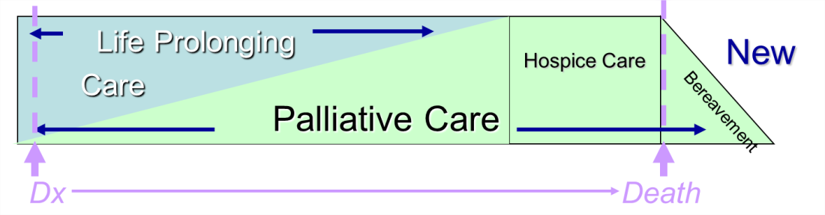
1. Consensus Statement
What is Good Palliative Care?
Recommendation: Adopt national recommendations
  4 Key Elements from AAHPM (next slide)
  CAP-C (Center for Advancement of Palliative Care) - NQF 38 Preferred Practices (see Appendix)
http://www.aahpm.org/Practice/default/quality.html
Notes:
Jim

Slide 14
2. What to Call “It”?
What we found:
  Patients generally do not have negative feelings toward Palliative Care, but physicians sometimes do
    Good to avoid phrase “end-of-life”
    Requires education that palliation means relief of symptoms, not how long one would be alive, quality of life
    Palliative and Supportive Care (MCHLB program title)
    Literature supports Palliative Care
Recommendation:
Stay with “Palliative Care” and educate to what it is, as well as use other positive phrases
  “Supportive Care” is a good term
  Encourage phraseology such as “chronic management of symptoms”, “quality of life and disease management”, “balancing treatment with burden of symptoms”
Notes:
Slide 20-21 Key BPT Activities 2012-13 and our original Top 10

Slide 15

3. Develop Best Practices
Alerts, Tools, Guidelines
What we found:
Epic inpatient
  Consult notes built
  POLST order set created
  Absence of specific order sets
Ambulatory settings
  Use of POLST and 5 Wishes
  ++ GNP Palliative Care program
  MCMF in process of developing
Growing external resources
  Coalition for Compassionate Care, The Conversation Project, CAP-C, National Hospice & Palliative Care
Recommendation:
Adapt and grow our tools for system-wide Best Practice support
  Refine / create order sets
    Patient type/age specific
    Symptom management
    Palliative sedation protocols for extubated patients on medical floors
    Neuropathic pain
    Pediatric comfort care set, MCH
Notes:
POSLT updates 10/14 – pulmonary and critical care began the work – absence of order sets

Slide 16
4. Develop Referral Triggers
Referral Mechanisms
What we found:
No clear mode for referral to Palliative Care or education
  Variable brochures in use
Some experience in Pediatrics on inpatient side
  CAPC’s pediatric palliative care referral criteria implemented by all 5 CareLines at MCHLB
  Lean workshop at LB, manual screening tool
Epic not helpful in capturing diagnostic triggers.
  Admitting diagnosis in Epic is typically not one of CAPC's diagnostic triggers.
  Neonatal ICU at MCHLB has been helpful (part of admission)
Recommendations:
Gain clarity on Triggers – e.g.
  Frequent admission: re-admitted with same diagnosis within 30 days
  Hospice eligible patients not psychologically ready for hospice
  Identify top “8” primary, advanced adult diseases:
    Heart failure, respiratory failure, malignancy, dementia, severe neurological disease, end-stage renal disease, end-stage liver disease, and HIV/AIDS
Develop clean request to build in Epic trigger mechanisms
  Learn from MCHLB & LB pilots – more team education on criteria (vs. the computer)
Notes:
1 & 3 pathway for referral and use of dx as triggers
building automated triggers to alert the team

Slide 17
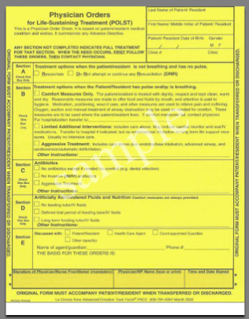
5. Evolve Our Use of POLST Leveraging the EMR
What we found:
Lack of understanding about what a POLST is and why needed:
  POLST = “Physician Orders for Life Sustaining Treatment”
Non-standard process
  Procedure varies from campus to campus, floor to floor, physician to physician, even nurse to nurse
Kept in paper chart but difficult to access
Recommendations:
Educate physicians to include POLST on problem list
Implement POLST “banner” in chart that carries over from admit to admit
Finalize POLST order set

Slide 18
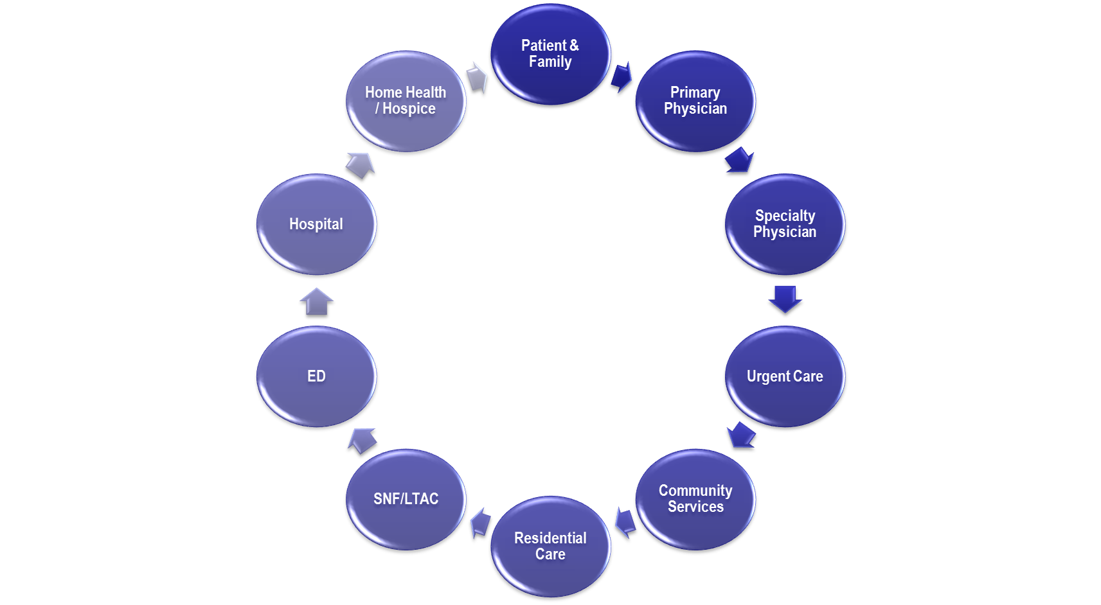

6. Create Seamless Handoffs across Continuum
What we found:
Another big gap
From current state to seamless flow:
Recommendations:
Develop electronic communications capability
  Epic screen (Epic IPA) w/banner
  Recurrent patients: Added to in-house Palliative census
  Centralized access (Hospice, Home Health - HH, SNF/LTAC, Medical Groups)
Leverage human resources
  Navigators link-in & update universal EHR system
  HH Navigator conduct telephonic case conferences
  HH Navigator connect w/PCP (every “x” weeks)
Connect with key audiences
Notes:
Identification and coordination – ongoing work
Hardwiring our communication of PC patients
As we building increased capacity in the op arena how do we smooth the transitions
Two way feed patients are identified and consulted in the PCP office or in the acute setting.

Slide 19

7. Develop Education Plan for All Key Caregivers
What we found:
HUGE gap, from basic to mid-level understanding of Palliative Care
  Why, what, who, when, where, how, which
  What does P&SC have to offer…, why want to call
Recommendations:
Develop comprehensive education plan, modular, e.g.
  Definitions – what PC is, care/symptoms, POLST
  Early discussion is key
  How to have the conversation
  Role of a PC team vs Hospice
  Considerations for ethnicity/diversity
  Pain management
  Resource availability
  Metrics that matter
Create algorithm of what tools can be used, & when
Create CME/CEUs
Create shared resource library, blog, connections
Notes:
Jim

Slide 20
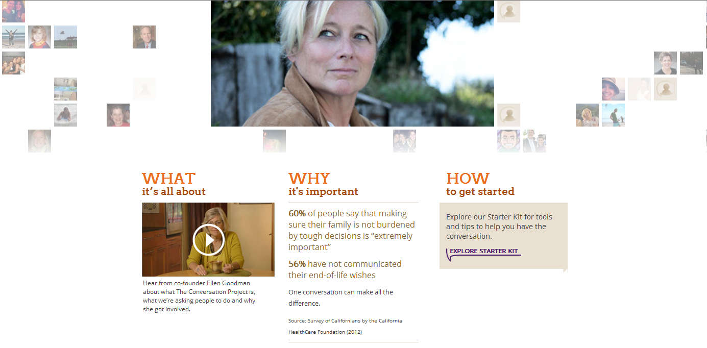

The Conversation Project
http://theconversationproject.org/
Notes:
LB Aligning incentives/goals across locations of care and by provider groups. Adopting and expanding national projects

Slide 21
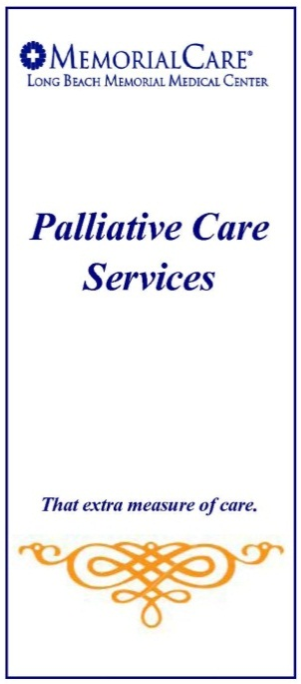

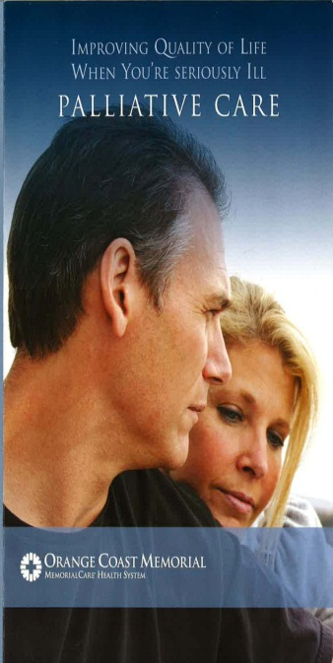
8. Develop & Provide Patient & Family Resources
What we found:
Variability in how we describe and “market”
Opportunity for standardization of educational material content campus to campus
Recommendations:
Develop persuasive resources for patient/family
  Develop a variety of options for delivery depending on learning method preference/opportunity
    Brochures, videos, one-on-one education
    Keep it simple
Educate ambulatory physicians and hospitalists on patient education tools
Notes:
We are in the process of developing an assest map so the practitioners can be aware of all available services and how to access them. This will also assist us in understanding where there may be gaps and prioritizing our build and spread strategy.

Slide 22
9. Advance Our “Best Service Models”, over time
What we found:
Need for programmatic support for inpatient and for continuum
Outpatient focus and inpatient focus varies (see next slide)
Each of our hospitals is different in terms of size/type.
  Consideration of ratios/bed size, population-specific influences (pediatric, geriatric, cancer)
  Where to start, capacity and mindset varies
Recommendation: Identify key team members, start/grow and then scale up
    Year 1-2 Phase-In
      Education for practitioners & staff
      Focus first on patients with new diagnoses
      Name the Inpatient Resource Team
      Foster cross-campus collaboration
      Pursue improved access, care and cost efficiency for outpatient service(s) starting with Medical Foundation models (MG, IPA)
    Year 2-3 Longer-Term
    Build longer-term “Palliative Care system” across the continuum
    Evaluate feasibility of regional outpatient clinic/service for PC and symptom management
    Continue research/learning
Notes:
Workflow
Building outpatient capacity

Slide 23
10. Data, data, data
Develop key measures and analytical support
What we found:
We have very little, outside of MCMF data and some at Long Beach from their program
This is analytics intensive
Recommendations:
Develop data sets to help us better understand our opportunity and track progress (but don’t wait for)
Develop a True North metric set (dashboard set)
Triple Aim Metrics (and level of complexity)
Quality/Outcomes
% Patients with Advance Directives (AD)
Interval between AD and death
Degree of effective symptom management
Advance Directives followed
% Deaths with Hospice & Palliative Care
Experience of Care
% of Heart Failure, and of Cancer, patients with > 2 admissions that receive PC consults
HCAHPS rating of pain control in chronic disease
Satisfaction of PC patients (optional Avatar module)
Location of death
Satisfaction of families
Quality of Life score
Affordability/Total Cost
# of ICU days before an inpatient death
Hospital days (managed lives)
ED visits (managed lives)
Total cost of care
Notes:
Jim

Slide 24
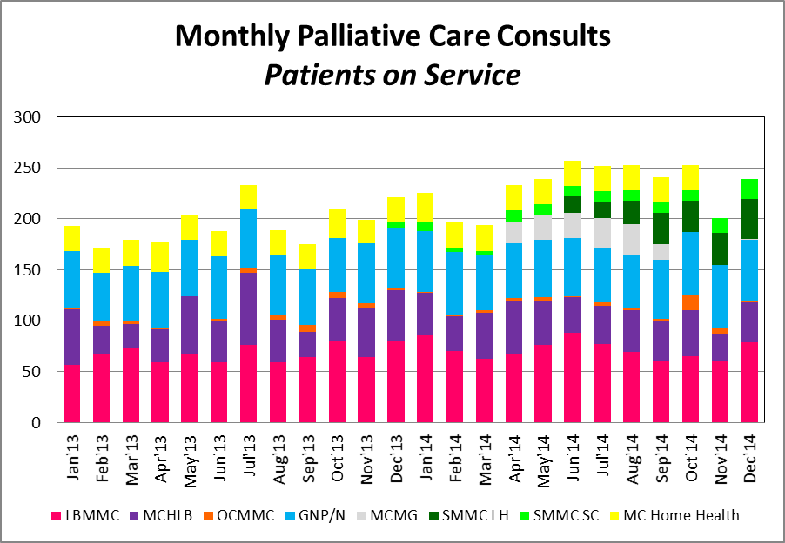
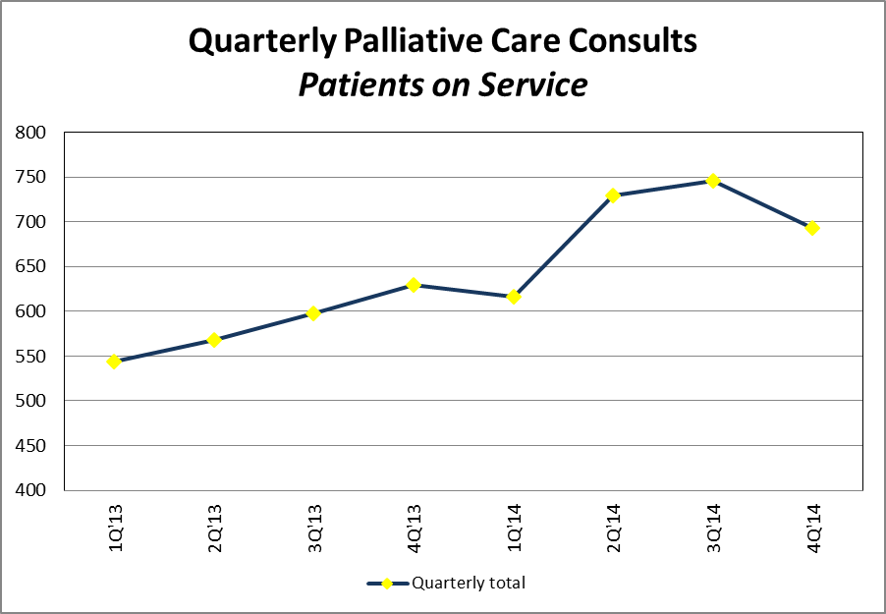
Results – Increase in programs and patient contacts
We started with services at:
GNP IPA outpatient
Long Beach Memorial inpatient
Miller Children’s pediatric inpatient
And We’re Growing with added services at:
Orange Coast ICU focus
Saddleback inpatient
San Clemente inpatient
Medical Group clinics

Slide 25


Slide 26
MHS major opportunities
Team Planning
Current work in progress @ MemorialCare
  Discharge Clinic - LB
  High risk patients- SB/LB
  COPD/CHF outreach- LB
  Palliative Care Clinic – Dr. Kleinman
  Coordination among certified Home Health and Hospice - SB
  Home Visits with NPs/Pharmacy for home bound
  Meetings with SNFs to get a sense of how they are willing to partner with us
Notes:
Development of assets grid – our talent pool includes 4 certified PC Physicians, Multiple PC APN, SW, Hospice
As we dishcarege pts, we need to plug them in to a supportive programb

Slide 27
MHS major opportunities
Team Planning
Potential areas for development or expansion: Building capacity
  Need 24/7 Hospice throughout system
  Develop contracting, shared risk potential for select partners in the post-acute space
  HealthyRoads – Employees earn points by completing Advance Directive (2015 program)
  Need for Pediatric Inpatient Hospice program/facility
Notes:
Aligning incentives/goals across locations of care and by provider groups CHCF Grant funding collaborative work in outpatient PC payment models

Slide 28
Vision to Execution:
Advanced Senior Care
Continued Development Towards Full Continuum of Care
  Establish Vision for Advanced Senior Care
  Leverage Our Community Partners & SNF Relationships Towards Quality Metric Review
  Vision for Care to Home Bound Senior Patients
Action Point → Work Group:
  Advanced Senior Care: Post Acute, SNF, Home
Notes:
As we continue our work in Population Health Advanced Senior Care management and vertical integration of are essential elements to achieving seamless care delivery with points of service that meet the patient in the most effective, efficient, patient & family centric location

Slide 29
MHS major opportunities
Team Planning
Clarifying our approach
  Develop service delivery standards
  Workforce Strategy/Workforce enhancement – needed skill sets, SNF’ist, PC MD’s, NP’s
  Building reliability of service in post-acute services that we currently contract for
  Expect partners to work in info systems to exchange electronic patient information
Notes:
Developing partnerships with similar values and the ability to reliably provide needed services in patient centric ways. ED and readmission avoidance, & seamless care transitions, for example require a more refined patient access and triaging system. Patient and providers need to define and refine their communication and access expectations.

Slide 30
Palliative Care BPT
2014-15 Key Activities
Continued evolution of order sets and alerts in Epic
Increase program scale and sharing across all sites
Developing next level education and toolsets
  System-wide toolkit (brochures, education tools)
Participated in May 22 LA County Advance Care Planning Symposium
  Set ambitious goal to get to 100% completion of advance directives
  MemorialCare looking to support in Orange County also
  MemorialCare’s commitment:
    Educate 100% of MCMG physicians by June 2015
    25% of patients ≥ 65 yrs old will have completed AD by June 2015
    50% of patients ≥ 65 yrs old will have completed AD by Dec 2015
Notes:
A detailed outpatient capacity analysis is being performed to scope and size Palliative Care demand and resources needed to effectively meet that demand.
We continue to evolve and refine our programs and infrastructure while focusing on building a culture of cooperative and compassionate care.

Slide 31
CHCF Grant
5. Received and activated CHCF 6 month grant
To develop a scalable model for expanding Outpatient palliative care in Orange County;
Specific focus of bringing together a payer and provider organization.
MHS partnered with Monarch IPA and SCAN
Focus on OC patients who would benefit from PC services

Slide 32
Patient selection criteria
  Patients with life expectancy of < 1 year, often with one or more of the following:
  End stage disease (CHF, COPD, cancer, dementia)
  More than 2 hosps in 6 months
  High predictive modeling score for admission (e.g. LACE score – LOS, Acuity of the admission, Co-morbidities, ED visits in previous 6 months)
  Challenging pt and/or family social dynamics
  Declining functional status

Slide 33
Further dialog and questions
Thank you for having us present/discuss today!
Questions?
James Leo, MD – jleo@memorialcare.org
Regina Berman, RN, VP of Population Health – rberman@memorialcare.org

