Slide 1
Supportive Care Medicine Bradley T. Rosen, MD MBA FHM Medical Director Supportive Care Medicine

Slide 2
“America is in a state of crisis regarding the manner in which we care for people who are dying. Study after study documents that medical care for the dying is poorly planned and frequently ignores the treatment preferences of the patient and family. Pain is commonly under-treated -- or not even addressed -- even within our most prestigious teaching institutions.
Too often, and with no mal-intent on the part of the doctors or nurses, medical treatment directed at prolonging the patient's life ends up contributing to their pain, isolation, and suffering.”
Dr. Ira Byock

Slide 3
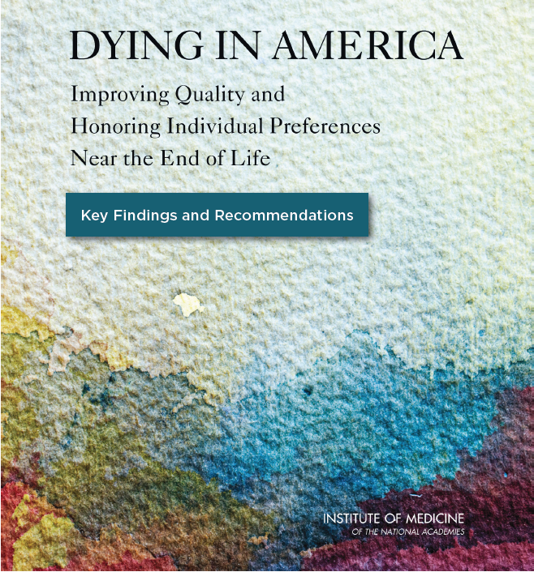
Key Findings and
Recommendations
Deliver more Person-Centered, Family-Oriented Care
Improve Clinician-Patient Communication & Advance Care Planning
Greater Attention to Professional Education and Development in being able to conduct crucial conversations
Align Policies and Payment Systems to enable/encourage providers to focus on EoL
Provide Public Education and Engagement to enhance baseline EoL understanding

Slide 4
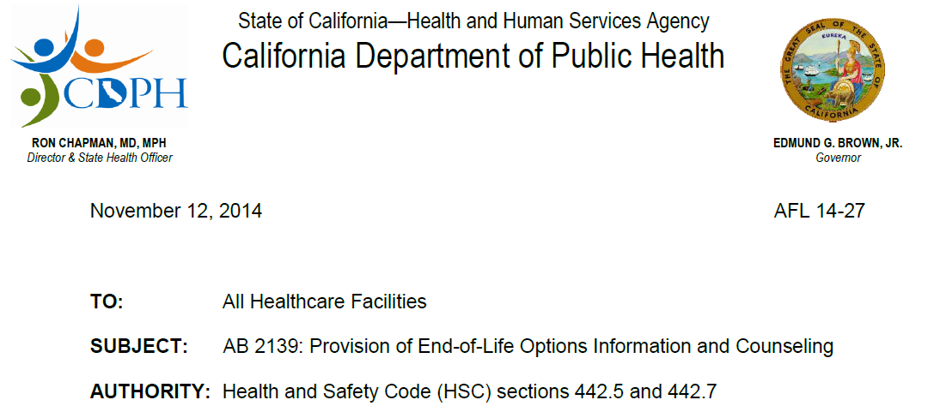

Slide 5
The Role of Supportive Care Medicine in Cancer Care
Cancer Care Continuum
Source: Institute of Medicine, “Delivering High-Quality Cancer Care: Charting a New Course for a System in Crisis;” 2013.

Slide 6
Supportive Care Medicine Ventricular Assist Device and CMS
Revisions have been made to the requirements for the disease-specific care (DSC) advanced certification program for Ventricular Assist Device (VAD) for Destination Therapy that align the requirements with the Centers for Medicare & Medicaid Services’ (CMS) final National Coverage Decision (NCD) memorandum for VADs for Bridge-to-Transplant and Destination Therapy. The changes include:
Adding a palliative care representative to the core interdisciplinary team
Deleting the board certification requirement for the cardiologist
Deleting the board certification requirement for the cardiovascular surgeon
Clarifying the volume requirements for surgeons in training
Modifying the requirements related to the use of a nationally audited registry
The addition of the palliative care representative to the interdisciplinary team will be required beginning October 30, 2014.
Source: CMS, “Update to the national coverage determination (NCD) for bridge-to-transplant (BTT) and destination therapy )DT) ventricular assist devices (VADs);” 2013.

Slide 7
Cedars-Sinai Health System
Supportive Care Medicine (SCM)
Vision
Treasuring each day, planning from the heart, and caring deeply for those around us
Mission
To compassionately care for each patient and family member who are facing advanced, life-limiting illness
Strategic Goals
Direct Patient Care—Provide high-quality, compassionate, and timely consultative input for patients facing advanced, life-limiting illness. Engage all members of the interdisciplinary care team to establish appropriate care plans for patients and their families. Focus on each person’s diagnosis, prognosis and treatment options, and hold paramount each patient’s goals, priorities, quality of life, and personhood.
Clinician Education and Research:
Empower non-palliative care clinicians with the tools, mentoring, and guidance so they can effectively incorporate “Primary Palliative Care” skills into their everyday practice.
Educate providers about the value of a Supportive Care Medicine consult and when requesting a SCM consult is appropriate.
Engage in clinical outcomes research on topics related to Supportive Care Medicine.
Community Outreach and Engagement:
Educate members of the broader Cedars-Sinai and Los Angeles community about the value of Advance Care Planning for themselves and their loved ones. Encourage all patients to speak with their primary providers about Advance Directives and end-of-life issues.
Explain the role that Supportive Care Medicine can play for patients and families when engaging in Advanced Care Planning or working through difficult healthcare decisions.
Provide resources (or identify existing community resources) to help people learn more about Advance Care Planning and take action.

Slide 8
We renamed our program at Cedars-Sinai from Palliative Care to Supportive Care Medicine. Why?
Answer: To Overcome Resistance to Palliative Care
41%
30%
Source: Dalal S, et al., "Association Between a Name Change from Palliative to Supportive Care and the Timing of Patient Referrals at a Comprehensive Cancer Center," The Oncologist, 2011;16(1):105-11.; Physician Executive Council interviews and analysis.

Slide 9
A New Paradigm for Supportive Care Medicine
29% of primary care physicians mistakenly believe that palliative care and hospice are virtually the same.

Slide 10
Core Elements of a High Quality Supportive Care Medicine Consultation*
Supportive Care Medicine (SCM) patients will receive a comprehensive assessment (physical, psychological, social, spiritual and functional).
SCM patients will be screened for paint, shortness of breath, nausea and constipation.
There will be documentation regarding patients’ emotional needs.
There will be documentation of patients’ spiritual beliefs or preferences not to discuss them.
SCM patients’ surrogate decision-maker’s name and contact information will be documented, or the absence of a surrogate will be noted.
SCM patients will have their preferences for life-sustaining treatments documented in the EMR, an Advance Directive, and/or POLST.
* Source: AAHPM and HPNA

Slide 11
Supportive Care Medicine New Consults
FY11- FY15* YTD (Jan)
Fiscal Year | 2011 | 2012 | 2013 | 2014 | 2015*
Inpatient Growth |  | 9% | 13.8% | -6.5% | 23.6%
Outpatient Growth | N/A | N/A | N/A | -23.2% | 73.9%
Total Growth |  | 9% | 37.1% | -9.3% | 30.9%

Slide 12
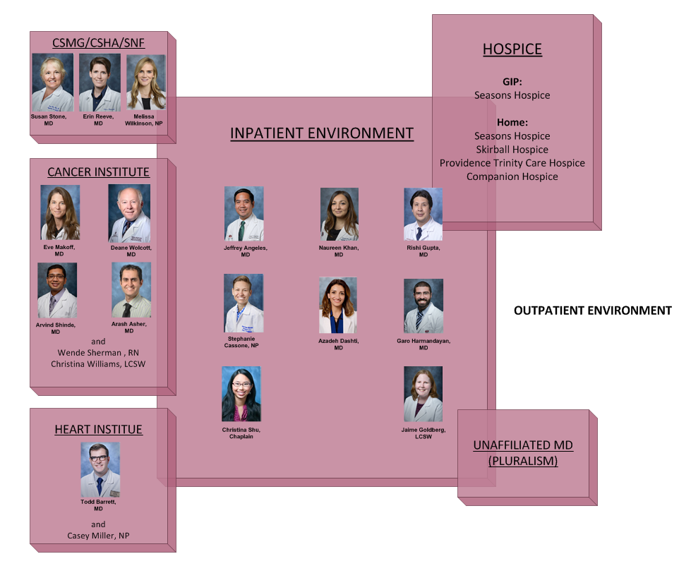
Cedars-Sinai Health System Supportive Care Medicine Team

Slide 13
Supportive Care Medicine/Heart
Todd Barrett, MD
Assistant Director,
Supportive Care Medicine/Heart

Slide 14
Objectives
Present Program structure
Understand TJC requirement
Explain MCS team structures
Review our current Supportive Care Medicine triggers

Slide 15
Cardiology at Cedars-Sinai Health System
Largest heart transplant program in the world
World leaders in total artificial heart implantation
Large quaternary heart failure referral center
Community cardiology
15

Slide 16
Getting Started: Doing A Needs Assessment
Interviews with Cardiomyopathy, Transplant, Cardiac Surgery, ICU attending MDs, and nursing leadership.
Based need on reimbursement, total cost of care, readmission, mortality, and volume.
Established a temporal list of Supportive Care Medicine (SCM) patient priority.
16

Slide 17
A 5 Year Journey for Supportive Care Medicine/Heart
Mechanical Circulatory Support
Corpuscular Membrane Oxygenator Patients
Advanced Heart Failure declined for Transplant
High Risk Transplant (status 1A patients without devices)
Pediatric Congenital Heart Disease
Class IV Heart Failure/Community Cardiology

Slide 18
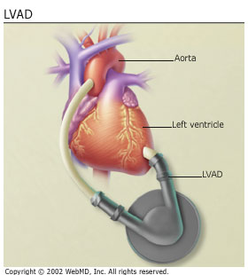
LVAD
Extends life with left ventricular failure
Used as destination therapy OR as bridge to transplant

Slide 19
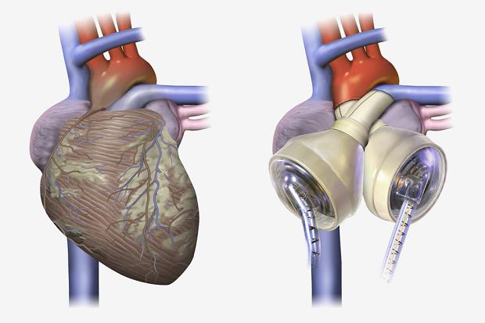
TAH
Extends life with biventricular failure as BRIDGE TO TRANSPLANT
No intrinsic cardiac function

Slide 20
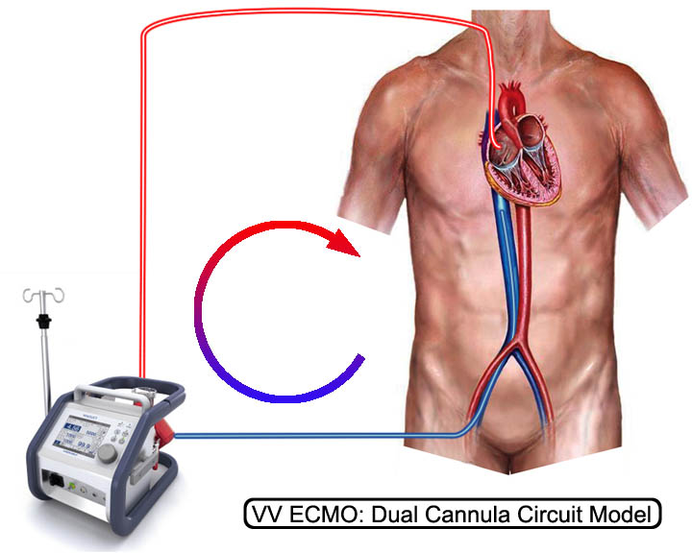
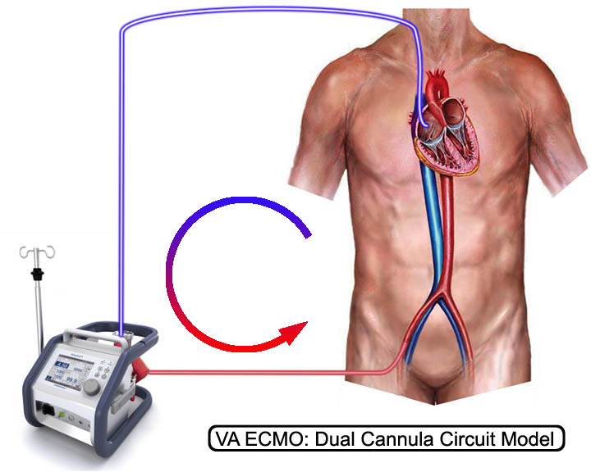
ECMO

Slide 21
Supportive Care Medicine Ventricular Assist Device and CMS
Revisions have been made to the requirements for the disease-specific care (DSC) advanced certification program for Ventricular Assist Device (VAD) for Destination Therapy that align the requirements with the Centers for Medicare & Medicaid Services’ (CMS) final National Coverage Decision (NCD) memorandum for VADs for Bridge-to-Transplant and Destination Therapy. The changes include:
Adding a palliative care representative to the core interdisciplinary team
Deleting the board certification requirement for the cardiologist
Deleting the board certification requirement for the cardiovascular surgeon
Clarifying the volume requirements for surgeons in training
Modifying the requirements related to the use of a nationally audited registry
The addition of the palliative care representative to the interdisciplinary team will be required beginning October 30, 2014.
Source: CMS, “Update to the national coverage determination (NCD) for bridge-to-transplant (BTT) and destination therapy )DT) ventricular assist devices (VADs);” 2013.

Slide 22
Diagnosis Related Groups DRG
LVAD DRG: $95,000 x 47 LVADS
Hospital stands to loose 4.47 million if CMS requirements are not met for DRG distribution

Slide 23
Interdisciplinary Team
VAD Coordinator
Cardiologist
Dietitian
Psychiatry
Social Work
MCS Patient
Supportive Care Medicine
Surgeon
Technology Team

Slide 24
Integration into Advanced Heart Care
Pre-MCS Evaluation
ECMO Care Plan
Transplant Selection Committee
Advanced Heart Failure
Notes:
Pre-MCS Evaluation:
Preparedness Plan
Minimal Acceptable Outcome
Discuss Device Discontinuation
Social Readiness
Close coordination with psychiatry and social work
Automatic Referral for ALL MCS patients
LVAD, TAH, ECMO
ECMO Care Plan:
Automatic consults for all VA and VV ECMO
Initiating protocol to start weekly family meetings
Surgeon
ICU Attending
Supportive Care Medicine
ECMO withdraw
Transplant Selection Committee:
Once weekly interdisciplinary meeting
Palliative care a voting member
Protocol developed for automatic referral for all inpatients declined for MCS/transplant
SCM will help communicate decision WITH the cardiology and surgery team.
Advanced Heart Failure:
Developing an outpatient cardiac hospice plan
Working with preferred hospices to provide care for advanced class IV heart failure in the community
Inotrope support
Dobutamine off patent $9/day
Dopamine $11/day
Interdisciplinary care plan involving Cedars-Sinai champions and hospice nurses for seamless transition of care

Slide 25
Lessons Learned
Transaortic Valve Replacement
Status IA Transplant Patients
Low EF Coronary Artery Bypass Graft
Research in quality metrics
No standards in new fields
How do we measure success?

Slide 26
Thank you!
Comments/Questions?
Contact Info: Todd.Barrett@cshs.org

Slide 27
The Integration of Supportive Care Medicine into Cedars-Sinai’s Cancer Center
Eve Makoff, MD
Assistant Director, Supportive Care Medicine/Oncology
Samuel Oschin Cancer Center Institute

Slide 28
The Name
At Cedars-Sinai/SOCCI, the name “palliative care” has been changed to “Supportive Care Medicine”.
An article in “Cancer” by Bruera et al 2009:“ Supportive versus palliative care: What’s in a name?” reported that using the name “palliative” vs. “supportive” care was a barrier to referral of patients for services.
Over 50% of respondents associated palliative care with hospice – or end of life care exclusively.
Supportive care was associated with treatment for side effects of cancer therapy.

Slide 29
Clinical Outcomes in the Literature
New England Journal of Medicine
Temel et al, 2010
Randomized control trial
Patients with non-small cell lung cancer
Improved quality of life
Longer survival (2.7 months)
*N Engl J Med 2010;363:733-42.

Slide 30
The Data
Zimmerman et al looked at 442 patients with metastatic cancer and compared “usual care” with early ambulatory palliative care (PC) with usual care and routine PC.
Results: Patients who received early PC reported greater satisfaction with care, better quality of life, and less severe symptoms at 4 months. (Presented at ASCO, Chicago June 1-5, 2012)
Bakitas et al looked at 332 patients with cancer and a prognosis of about 1 year to live and did interventions with Advance practice PC nurses.
Results: Patients assigned to PC had better quality of life and mood. (Enable II RCT. JAMA 2009; 302:741-9).
Notes:
They found that patients receiving early PC reported greater satisfaction with care, better quality of life, and less severe symptoms at 4 months. (Presented at ASCO, Chicago June 1-5, 2012)

Slide 31
The Data
The integration of PC into patient care has shown the following:
High cancer patient satisfaction
Improved patients’ understanding of their prognosis
Family/caregiver satisfaction
Decrease in burden
Decrease in unmet family needs
Improved satisfaction amongst oncologists and other physicians
Notes:
Multiple other studies have shown high satisfaction with outpatient palliative care services for patients in cancer centers, using validated instruments.
Also, family caregivers report satisfaction, decreased burden, and fewer unmet needs when their family members receive outpatient PC services.
Improved satisfaction has also been noted amongst referring oncologists and palliative care physicians themselves. Muir and colleagues, embedded in oncology offices, and estimated that tasks performed by PC consultants saved oncologists 170 minutes per referral over the course of the patient-oncologist relationship (Am J Hosp Palliat Care 1999;16:713-722)
Initiating palliative care upon diagnosis of advanced cancer also improves patients’ understanding of their prognosis – according to Dr. Temel’s follow up longitudinal study. J Clin Oncol 2011;29: 2319-26
Studies show that most patients with metastatic cancer incorrectly report that their cancer can be cured with cancer treatment. Weeks JC et al, NEJM 2012;367:1616-25
PC clinicians can help patients improve their prognostic understanding and thereby tend to help limit use of chemotherapy near end of life. Greer et al J Clin Oncol 2012;30:394-400 and Weeks NEJM (above).

Slide 32
The Momentum
Advocates interested in the implementation of palliative care include:
Boards and societies such as the IOM, ASCO, the Advisory board, Commission on Cancer, WHO, and NCCN
National payors and health systems
Our greatest challenge is to develop the capacity to meet the needs of all of our oncology patients.
Notes:
Boards and societies such as the IOM, ASCO, the Advisory board, Commission on Cancer, WHO, and NCCN are advocating for implementation of concurrent palliative care and cancer care from the time of diagnosis.
Nationally, payors and health systems have become interested in the exploring the potential benefits of expanded outpatient palliative care services.
If anything, our challenge is to have the capacity to meet the needs.

Slide 33
The Role of Supportive Care Medicine in Cancer Care
Cancer Care Continuum
Source: Institute of Medicine, “Delivering High-Quality Cancer Care: Charting a New Course for a System in Crisis;” 2013.
Notes:
“Patients are at the center…In the current system, information to help patients understand their cancer prognoses, treatment benefits and harms, palliative care, psychosocial support, and costs of care is often unavailable or not regularly communicated.
Additionally, patient-clinician communication, and shared decision making is often less than optimal, impeding the delivery of patient-centered, high quality cancer care.
Several recent studies found that …65-80% of cancer patients with poor prognoses incorrectly believe their treatments could result in a cure.”

Slide 34
Our Experience at Cedars-Sinai
June 2014 – Supportive Care Medicine (PC) embedded in Samuel Oschin Cancer Center Institute.
Joined an existing Supportive Care Service: Psychiatrist, PM&R physician, social workers, dieticians, and chaplain
Patients seen in the clinic by referral and followed inpatient when hospitalized.
Integration into several Hematology-Oncology committees, including:
Cancer quality committee
Division of hematology-oncology faculty meetings
Tumor boards
SCT M&M
RN educational meetings
Cancer committee 2015 quality goal re: PC involvement with advanced pancreatic carcinoma patients

Slide 35
Scholarly Activities
Abstract presented at inaugural ASCO –palliative care meeting 2014 re: use of ECOG scores to promote discussion around chemotherapy appropriateness.
Protocols in development involving, Phase 1 patients, head and neck cancer patients, improved distress screening and triggered palliative care consultation.

Slide 36
Lessons: The Essentials
Support from cancer center leadership
Visible presence at meetings, committees, clinic
Availability (within limits)
Collaboration with oncology colleagues : empathize with their perspective
Show your value: to patients, families and referring physicians
Communicate regularly with referring physicians. Honor that patient-physician relationship
Ask for resources so that you don’t fail
Collect data: we need more research to show our value and obtain further resources
Don’t take it personally: culture change is difficult
Notes:
Play nice!
Collaborate
Communicate
Show your value: to patients, families, and referring physicians
Be available…but set boundaries
Get involved – attend meetings, tumor boards, social events…make friends
Ask for help – push for resources when you need them
Don’t take it personally: culture change is hard.

Slide 37
Thank you!
Questions?
Contact: Eve.Makoff@cshs.org

